Slide 1
MD runs for HEO Potential
Using the Optimized F for MgNiO at different Temperatures

Slide 2
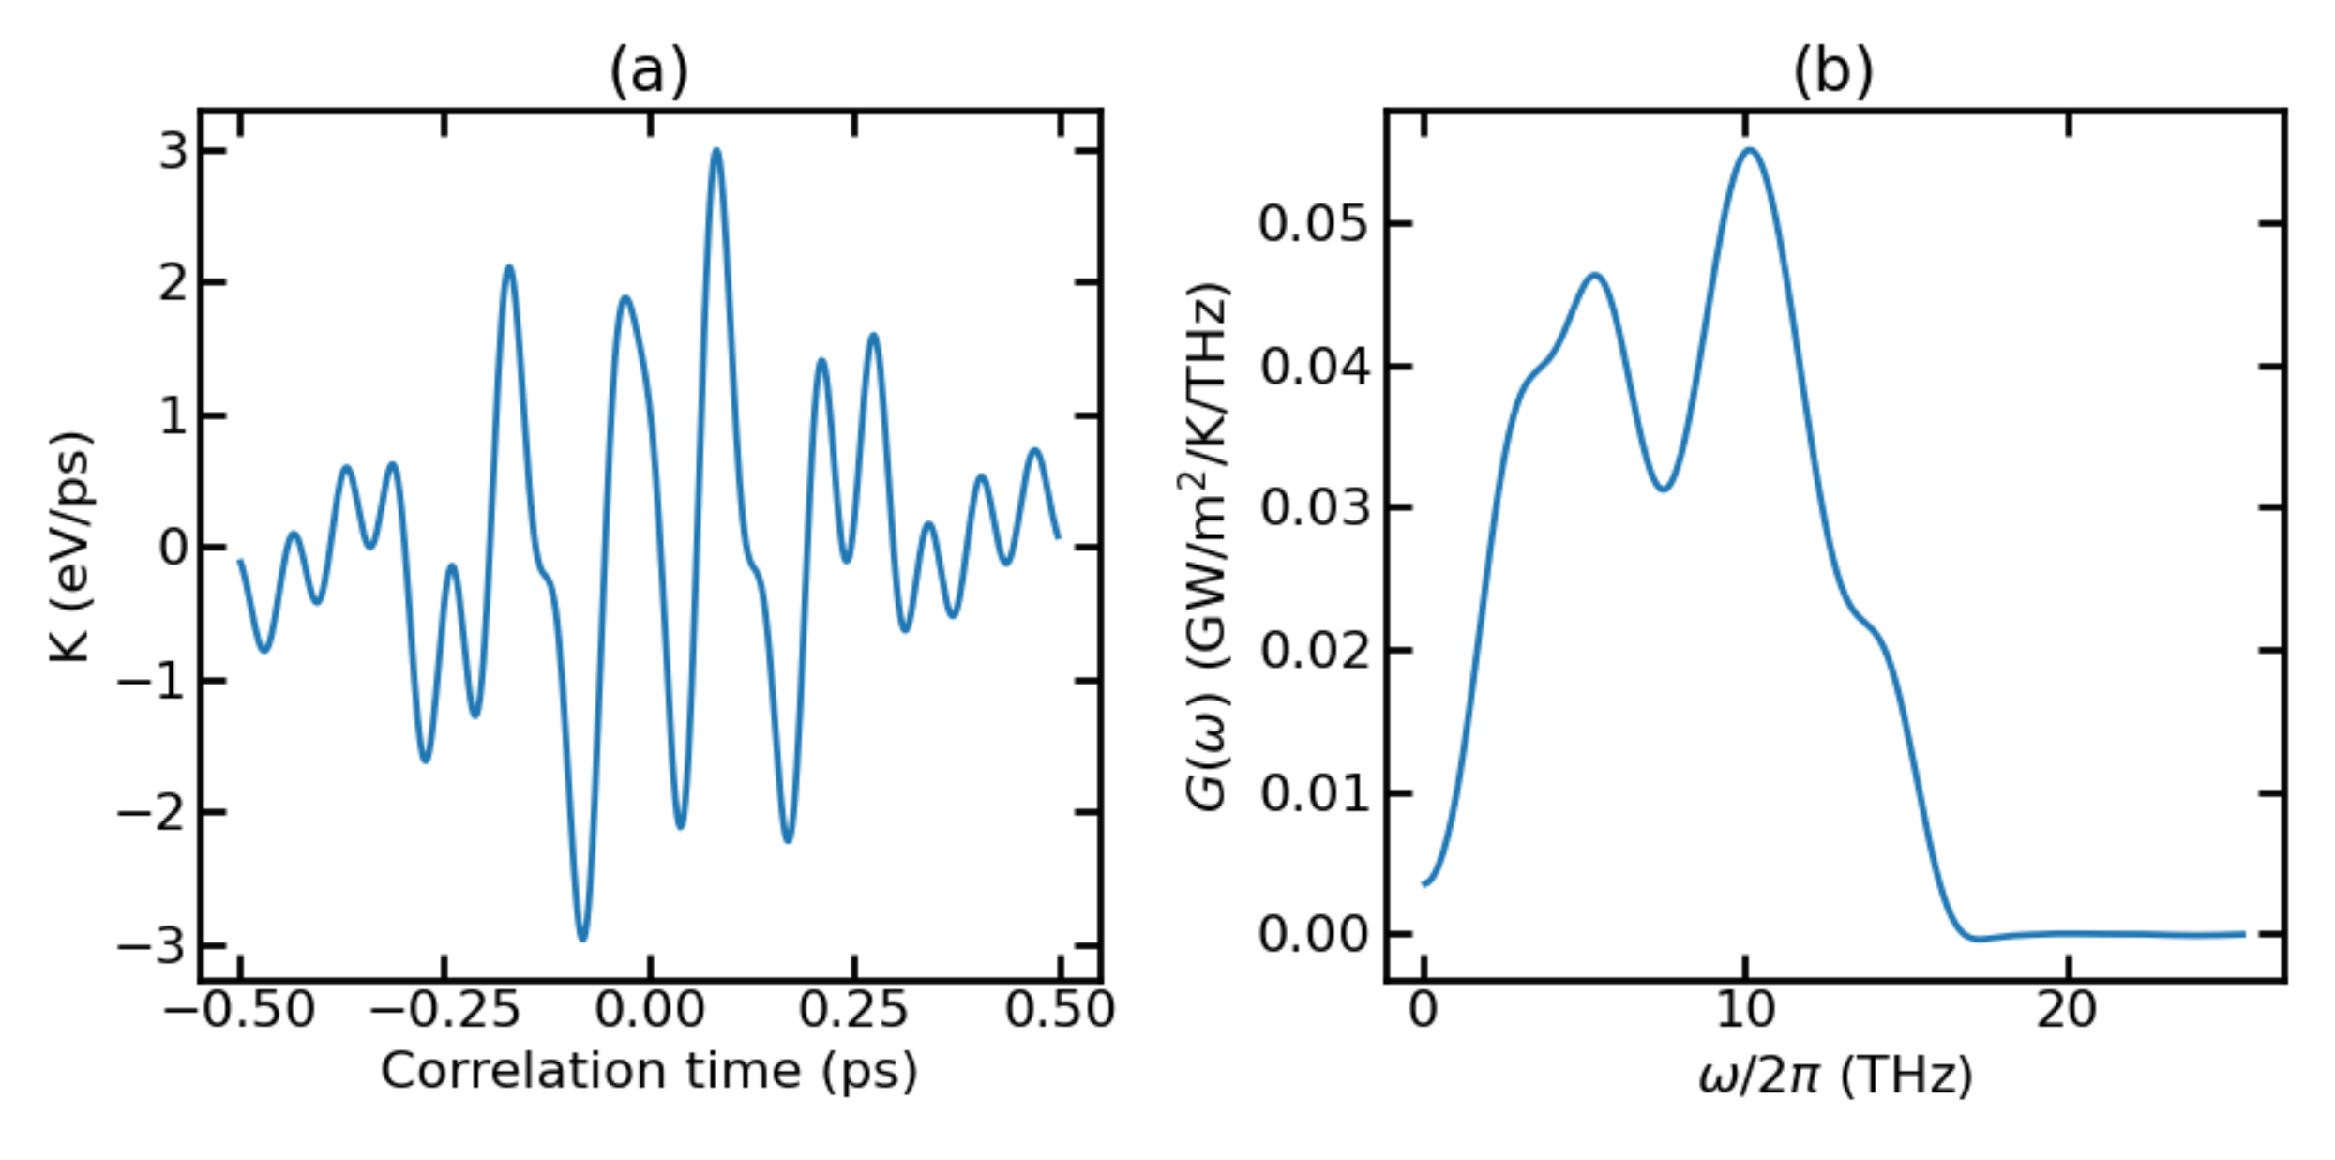
Temp_300K with F=0.00014

Slide 3
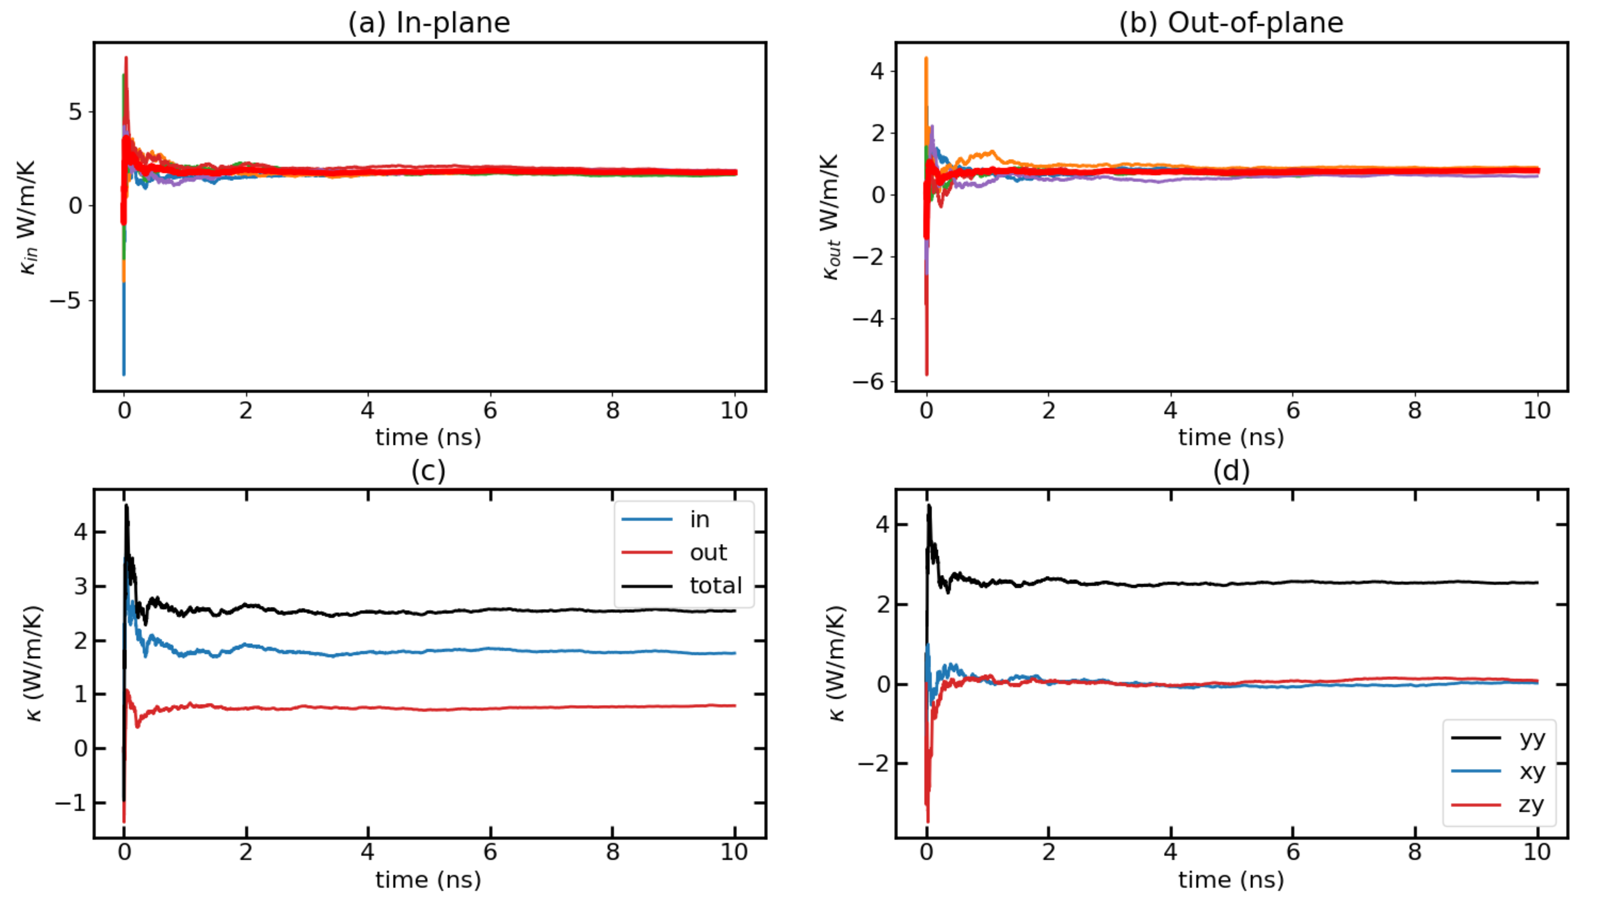
Temp_300K with F=0.00018

Slide 4
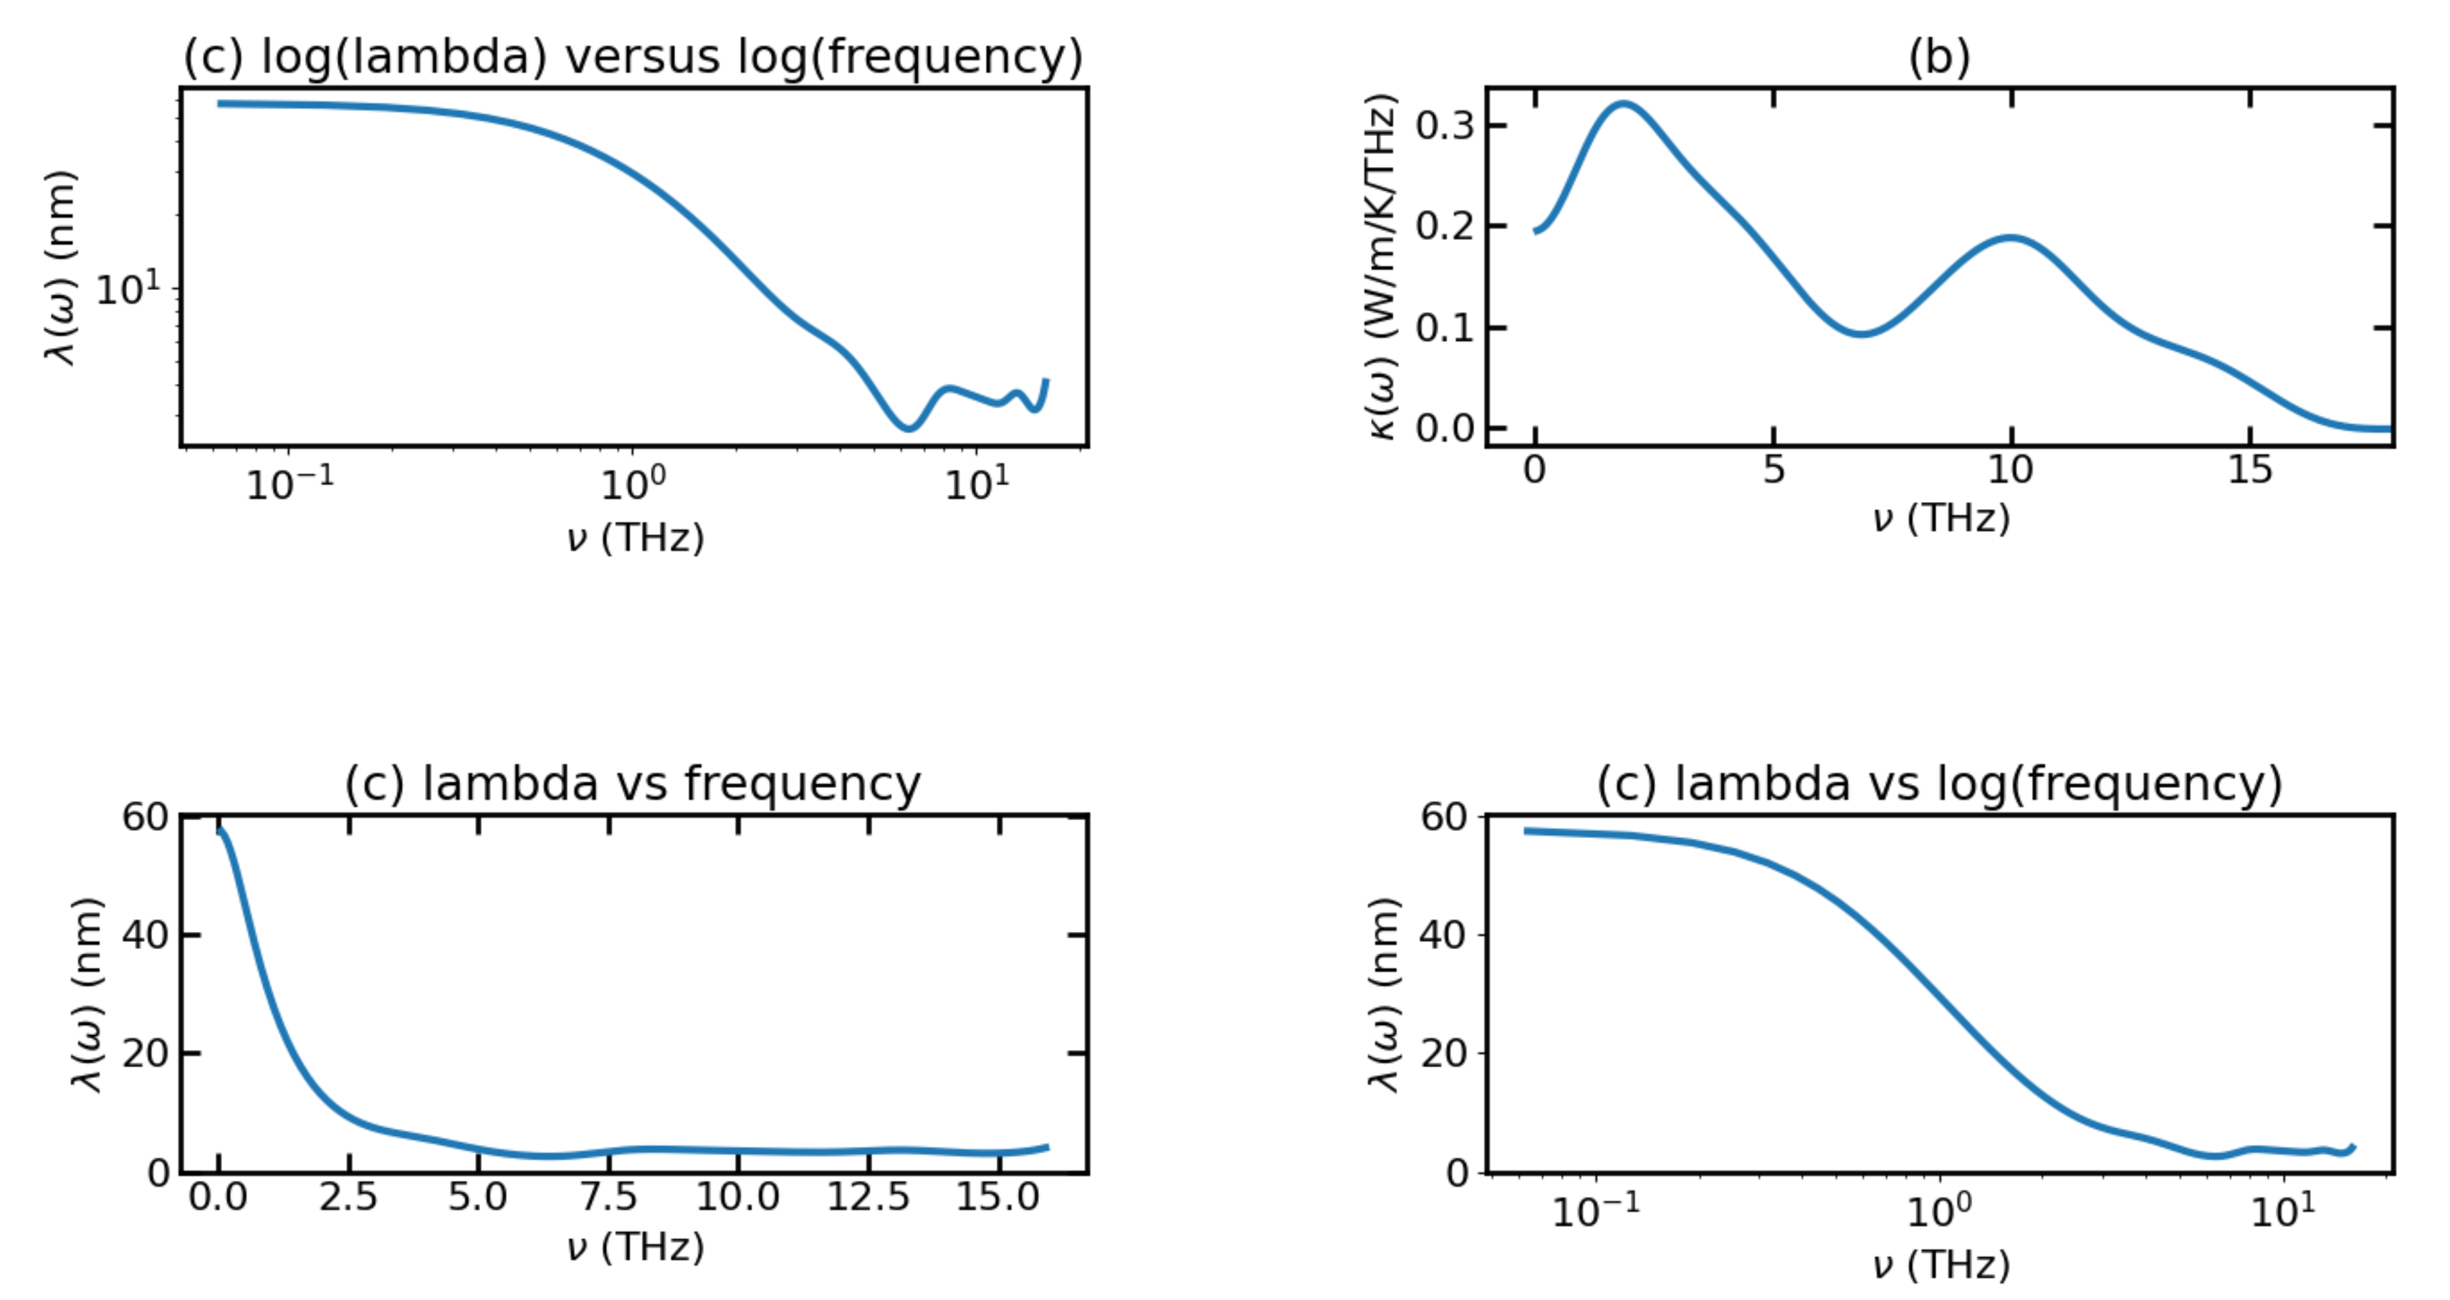
Temp_300K with F=0.00018

Slide 5
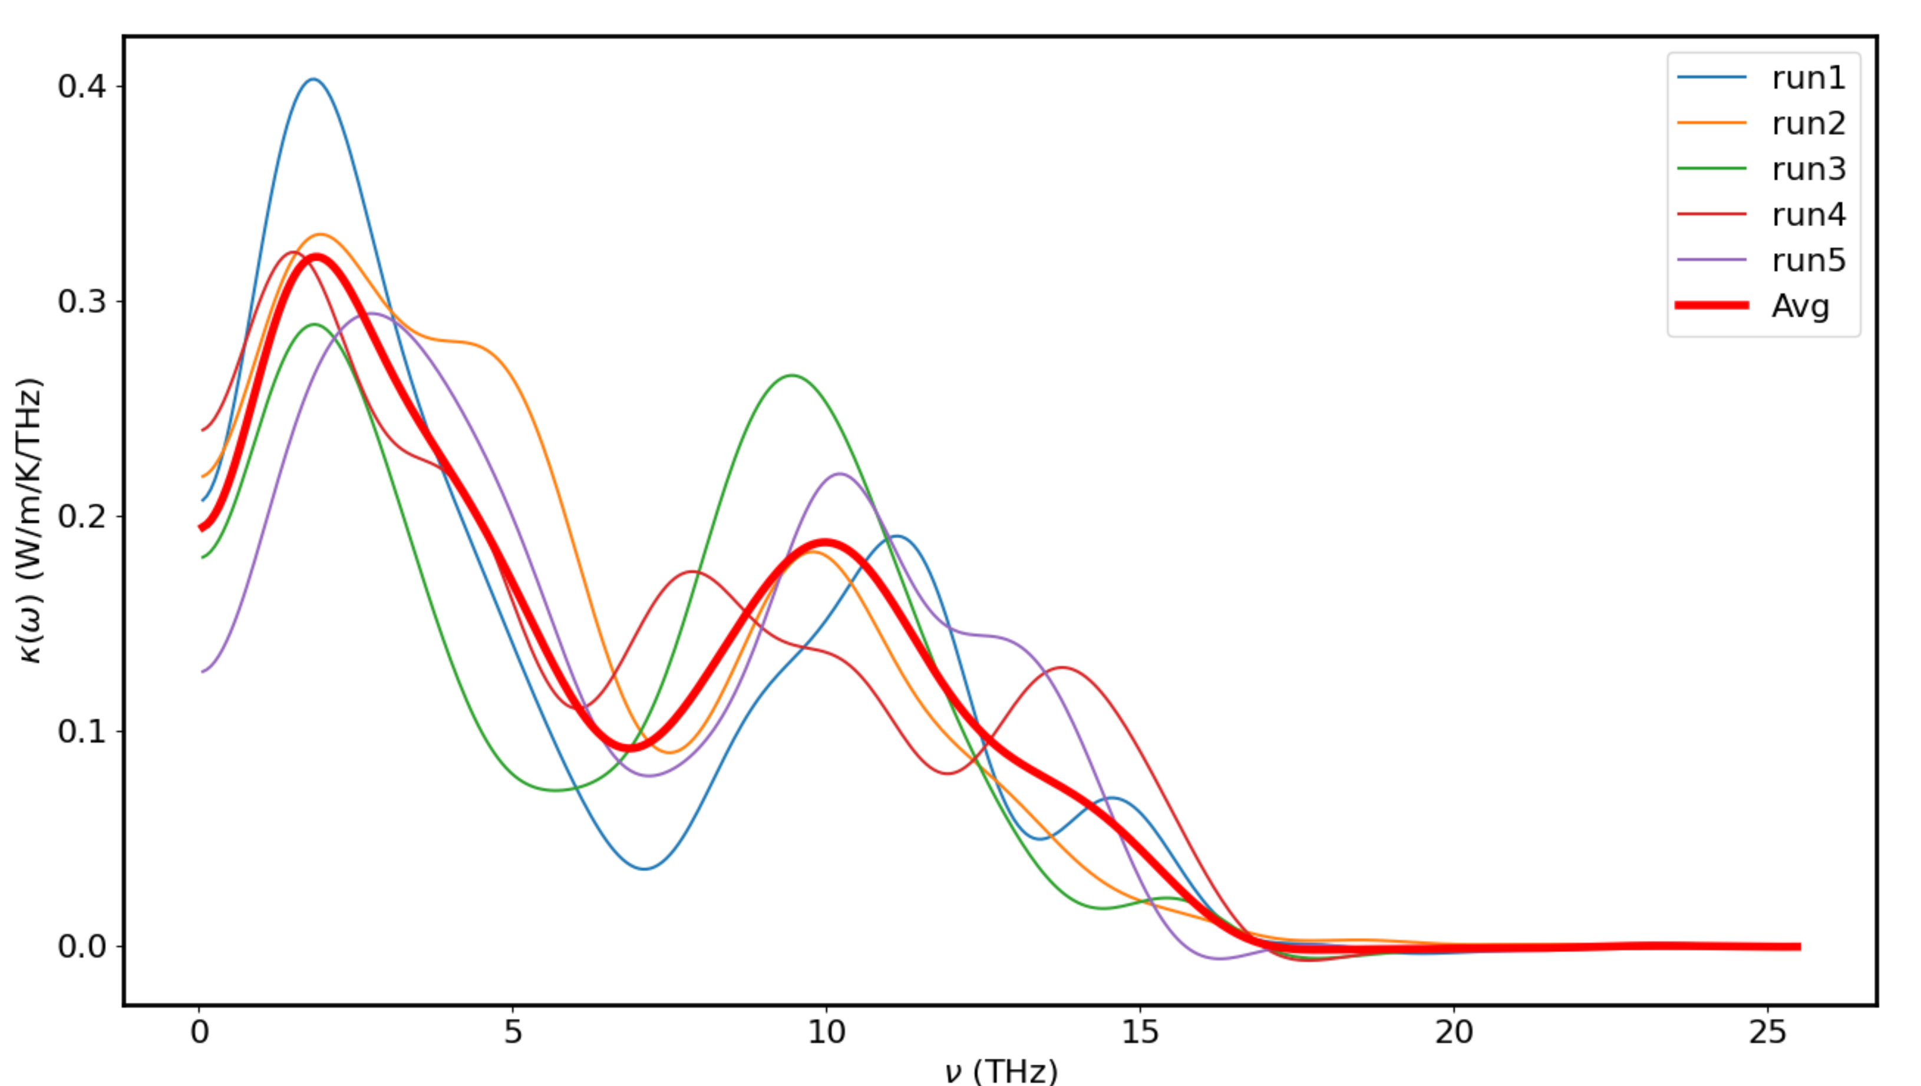
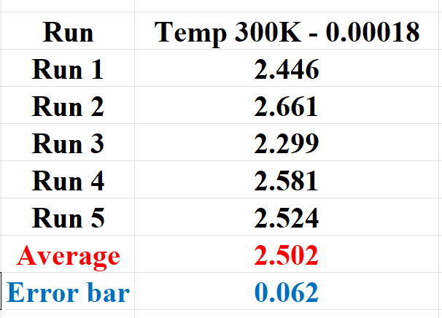
Temp_300K with F=0.00018

Slide 6
Npt runs for 300K
Lx: 42.73543636 to 42.72573034
Ly: 42.73551282 to 42.71805649
Lz: 42.7354391 to 42.76046392
No much change in Volume when doing the npts → we can use same V and same model

Slide 7
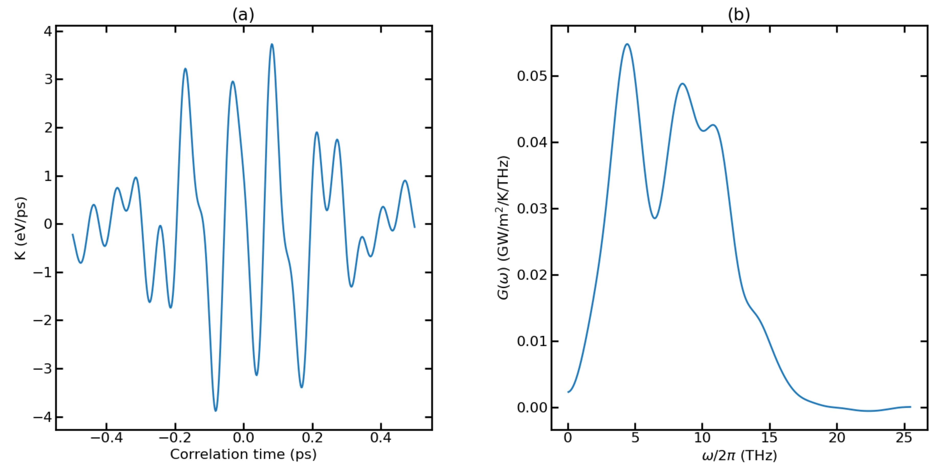
Temp_500K with F=0.00024

Slide 8
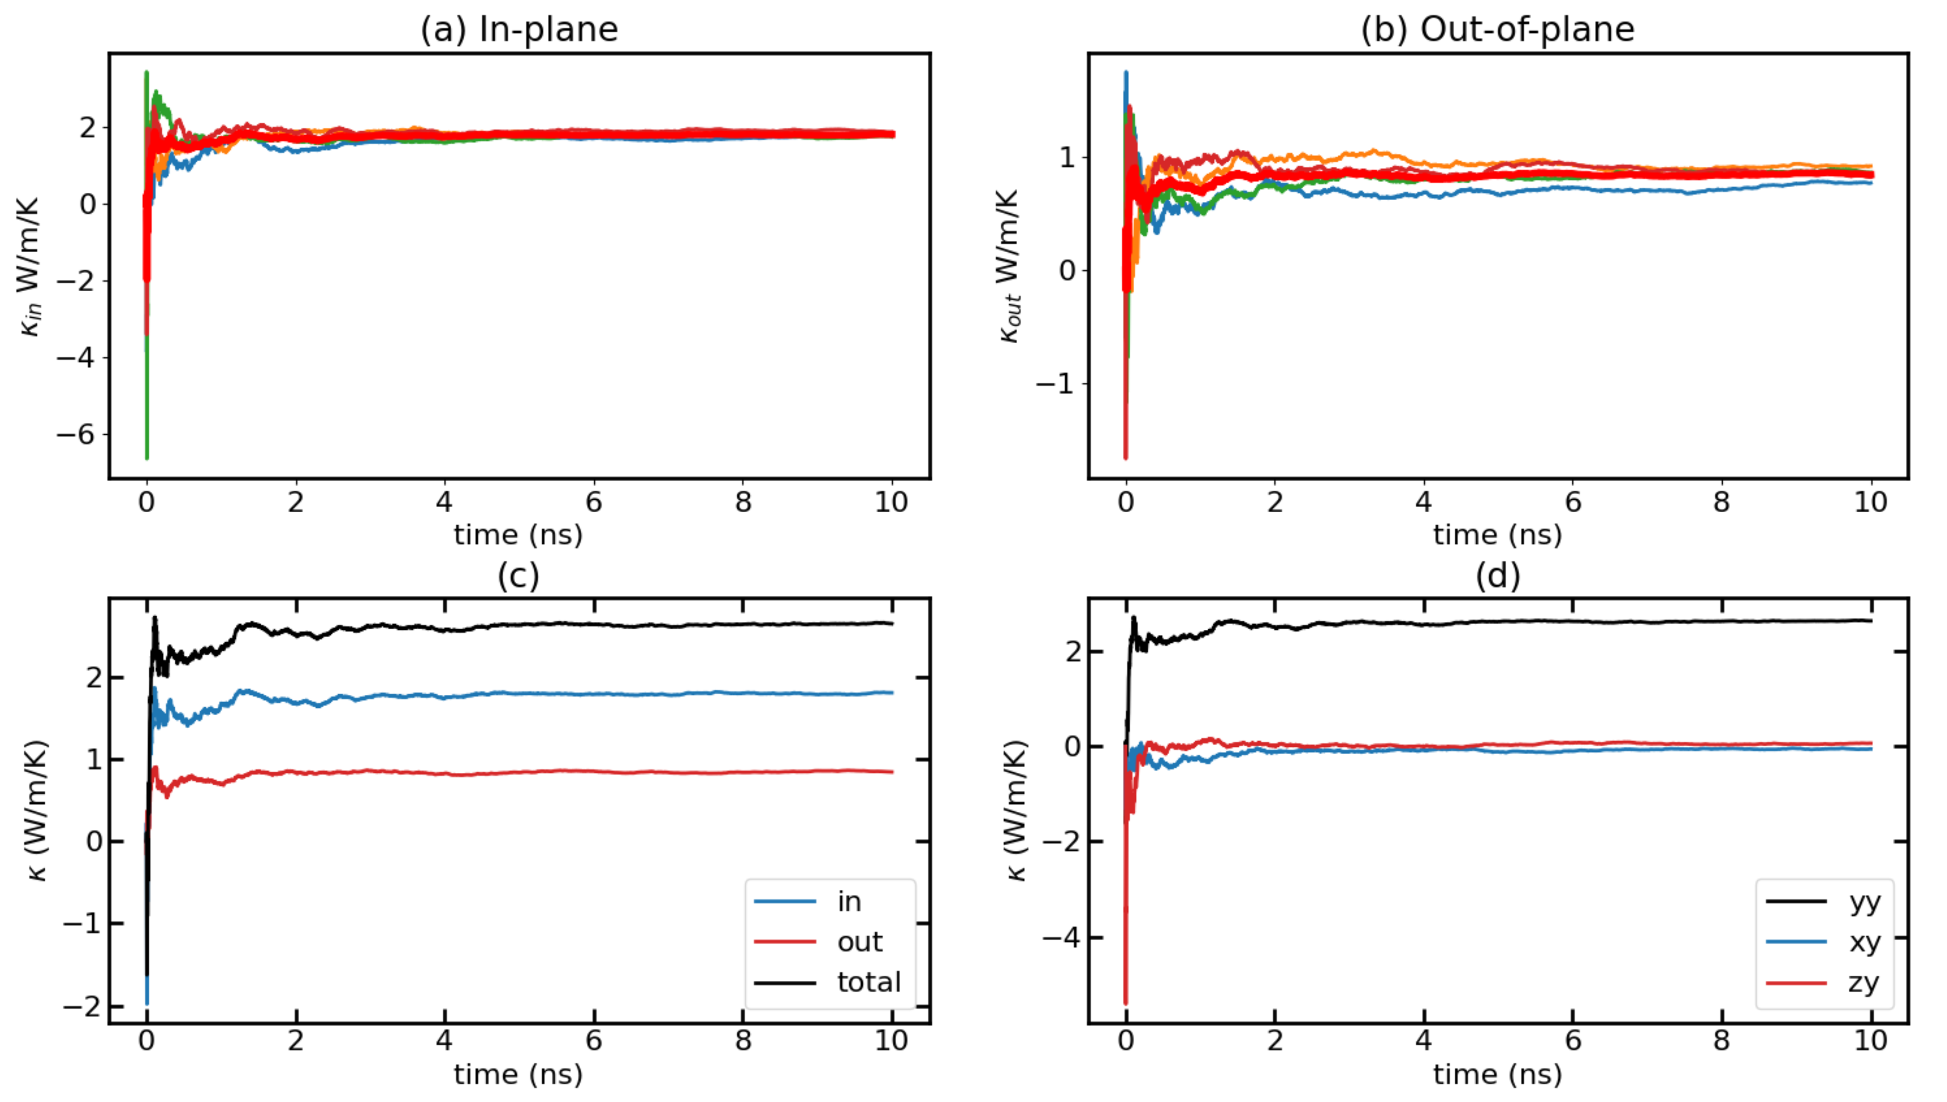
Temp_500K with F=0.00024

Slide 9
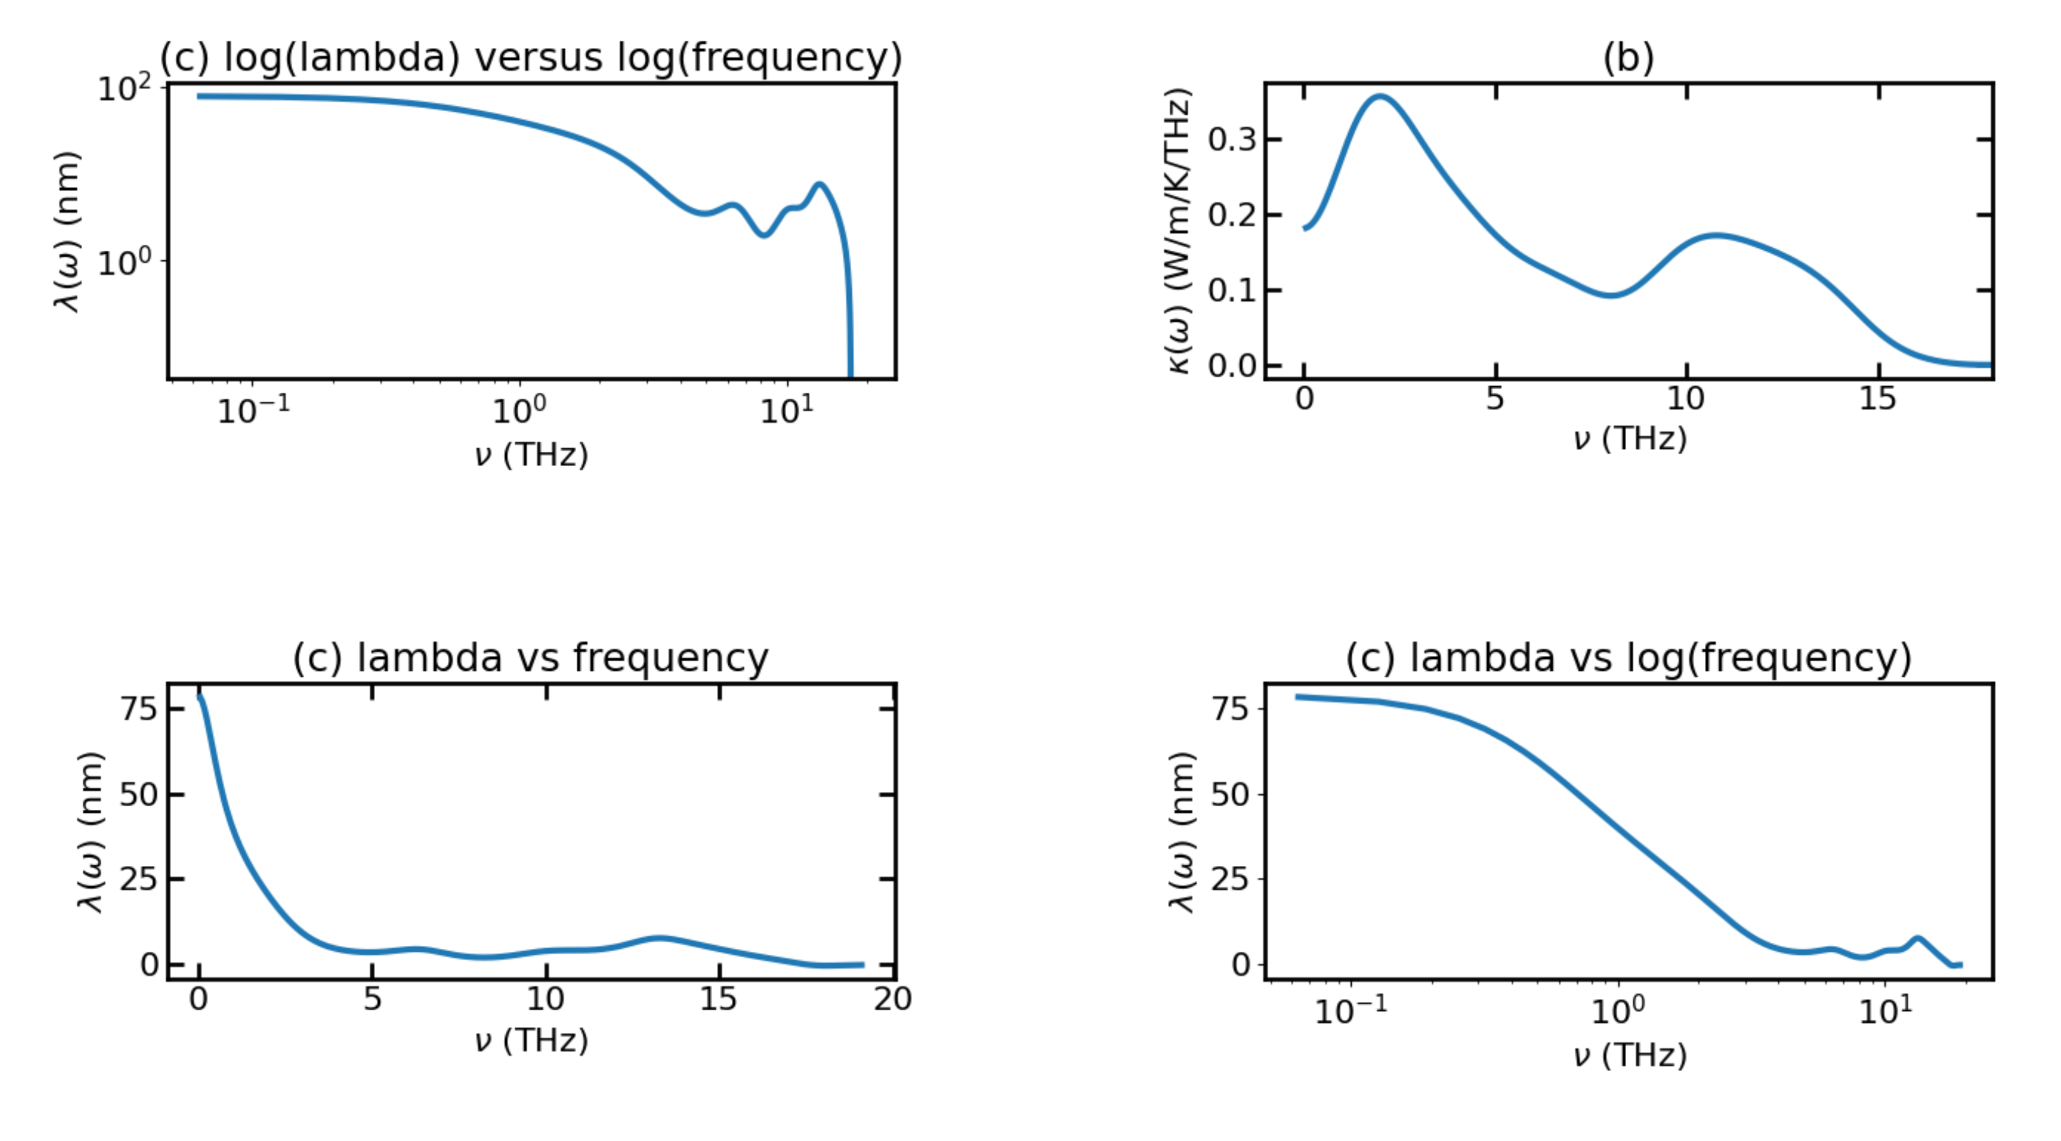
Temp_500K with F=0.00024

Slide 10
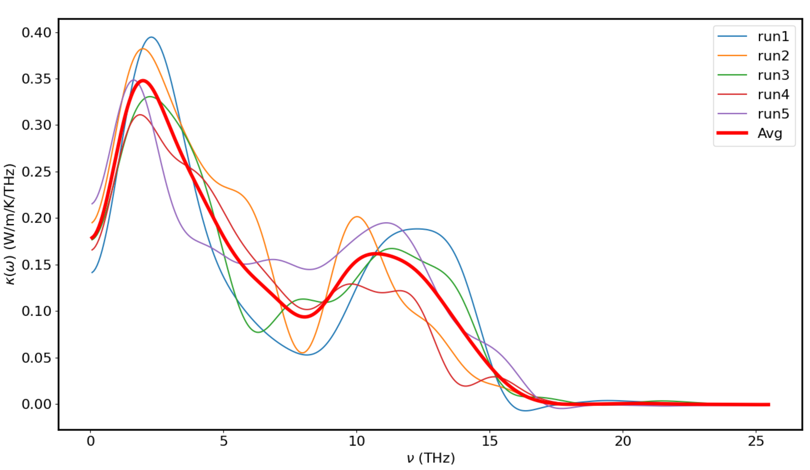
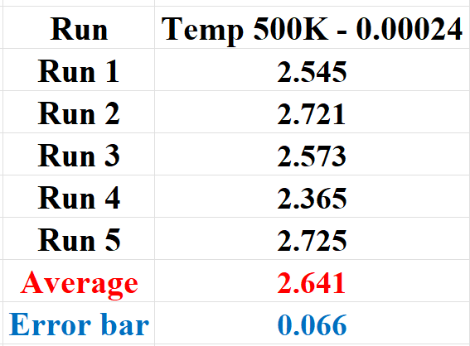
Temp_500K with F=0.00024

Slide 11
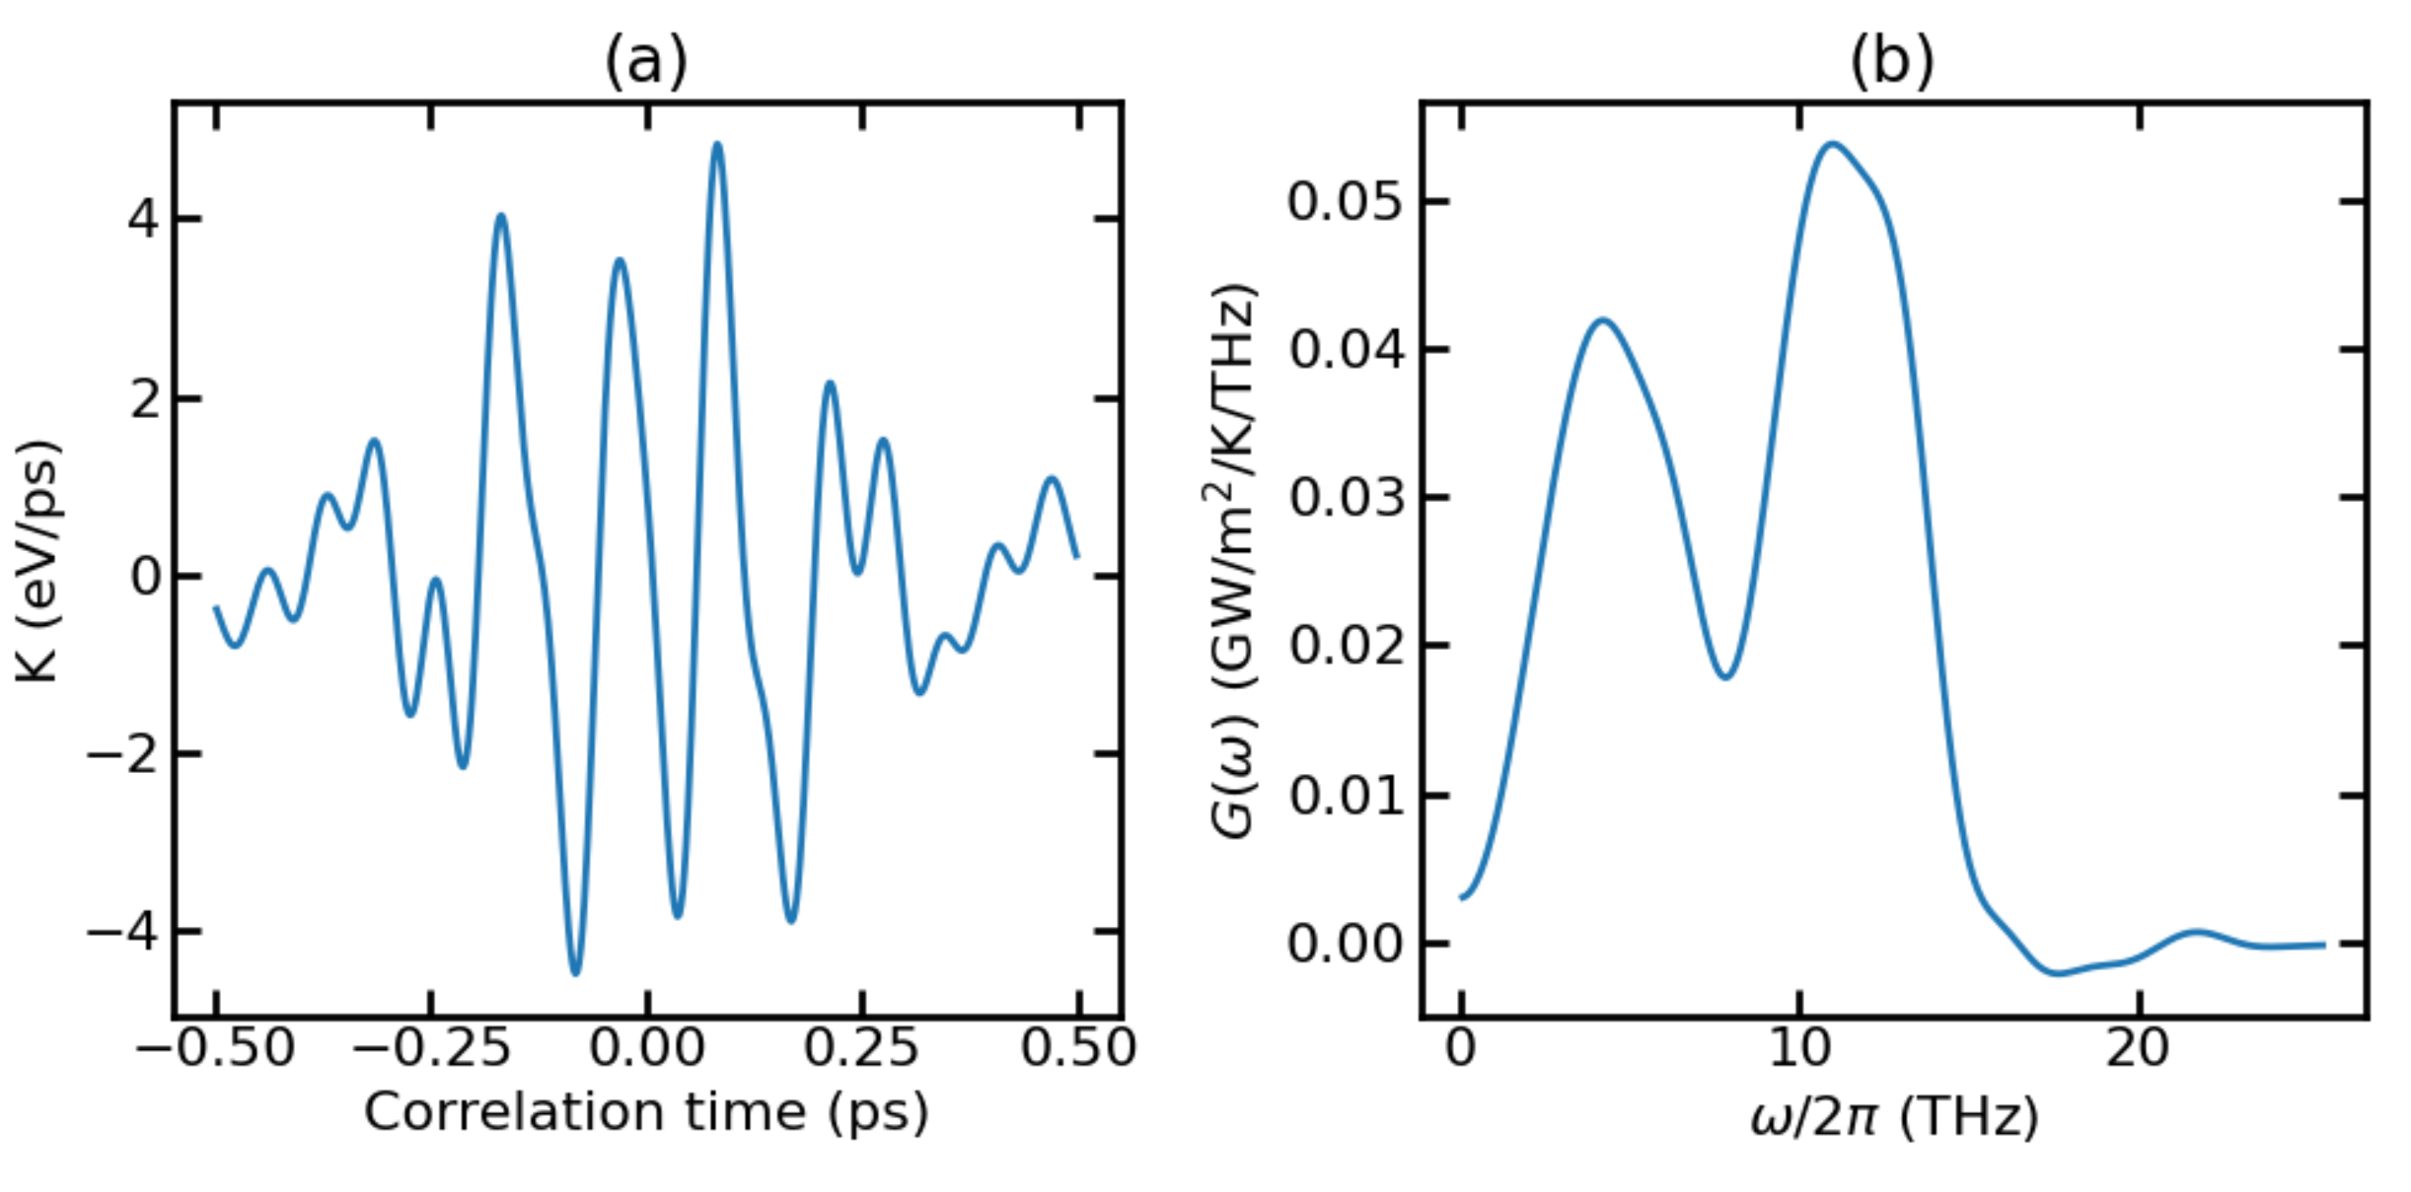
Temp_700K with F=0.00032

Slide 12
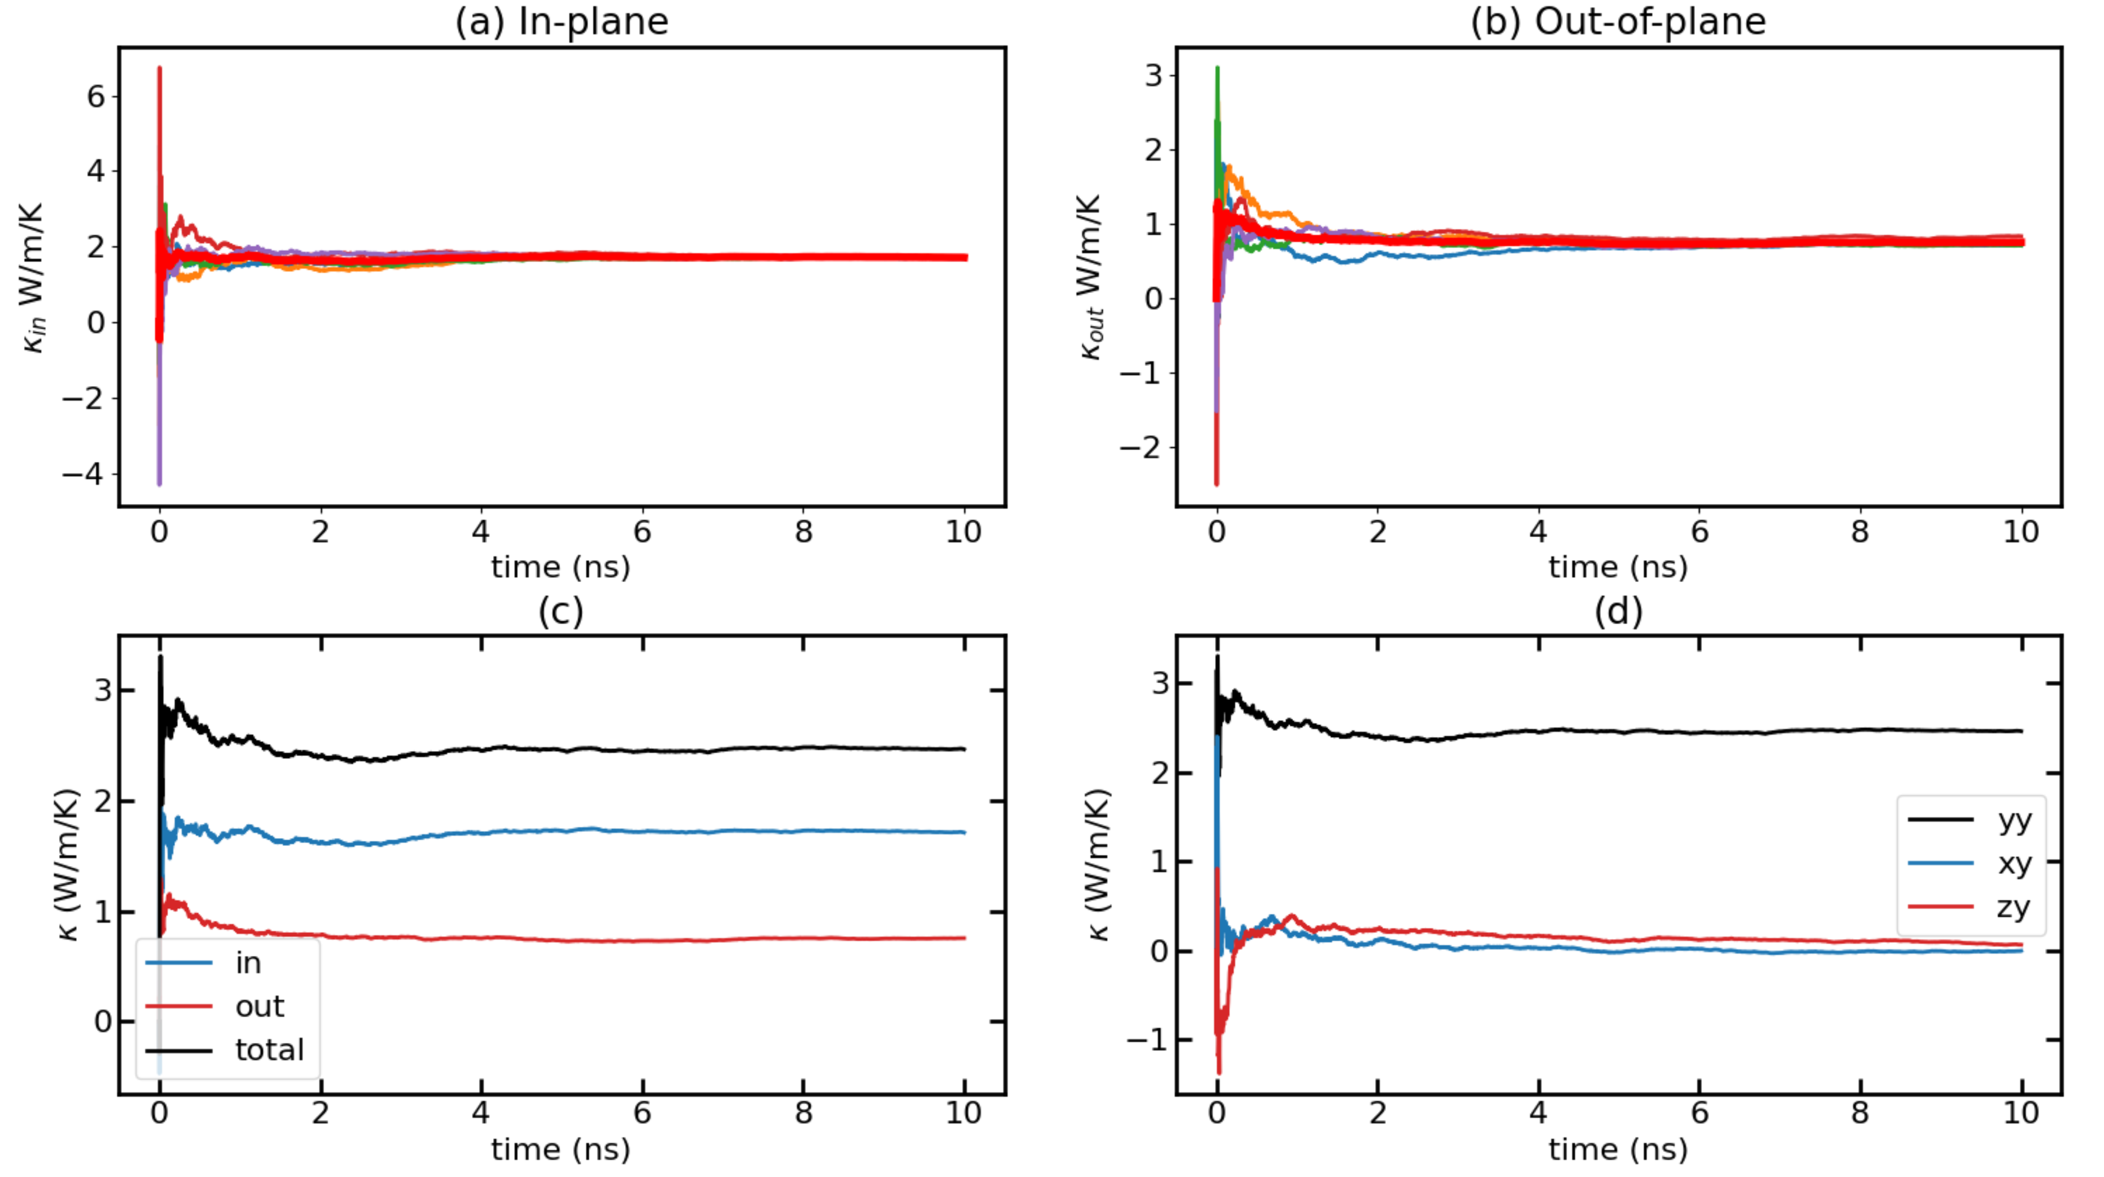
Temp_700K with F=0.00032

Slide 13
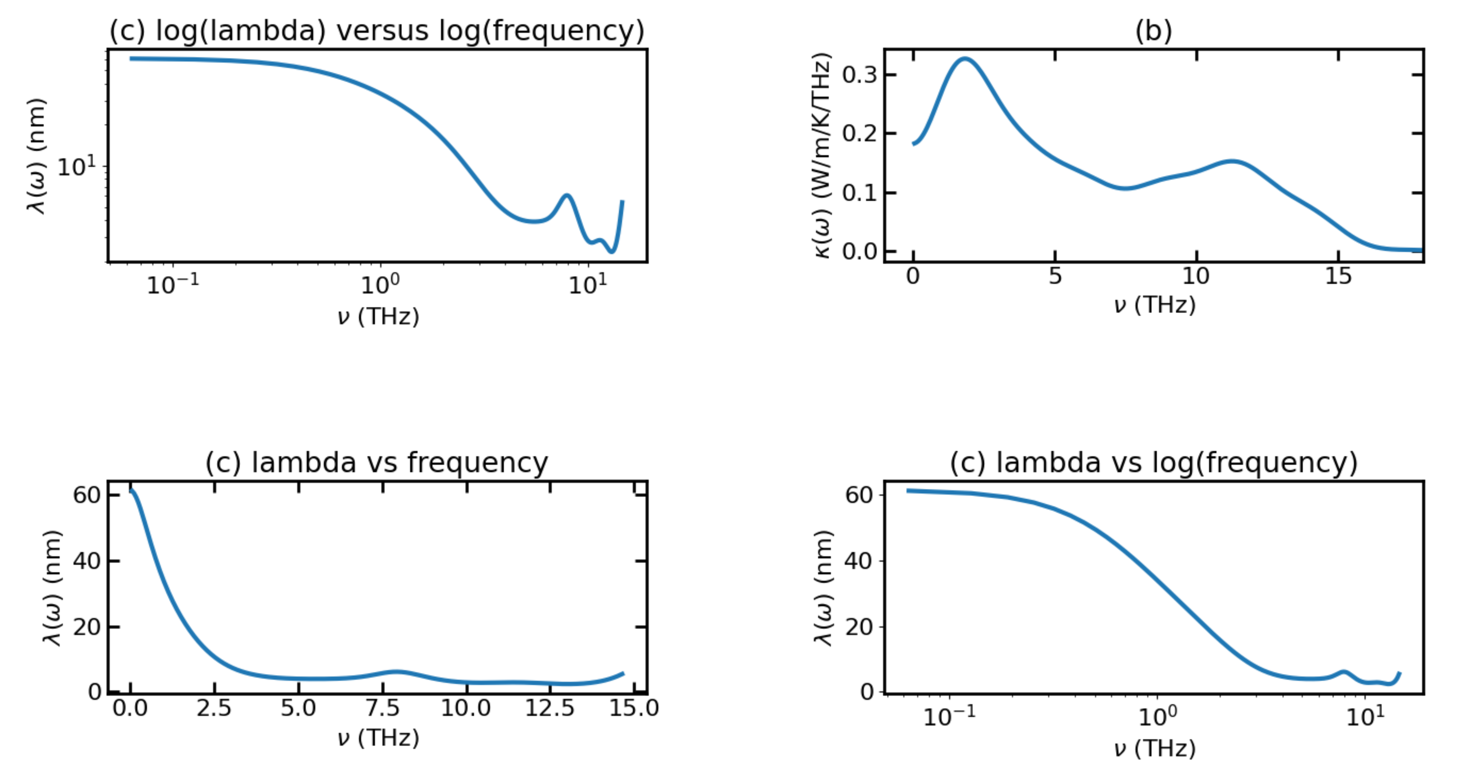
Temp_700K with F=0.00032

Slide 14
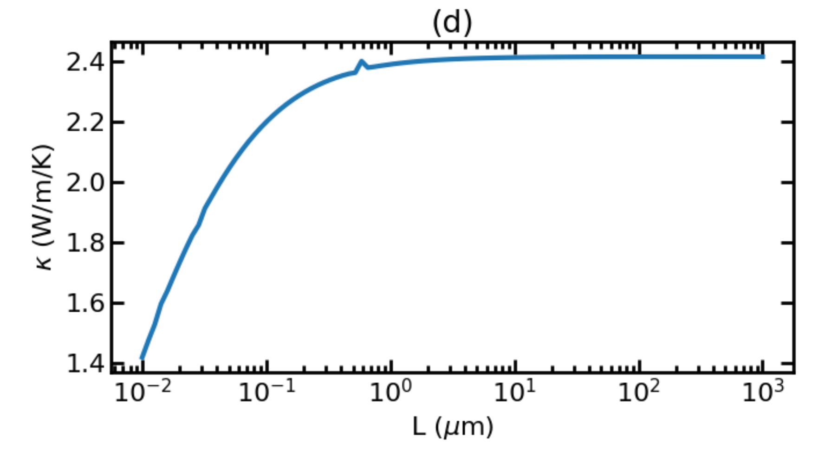
Temp_700K for L plot

Slide 15
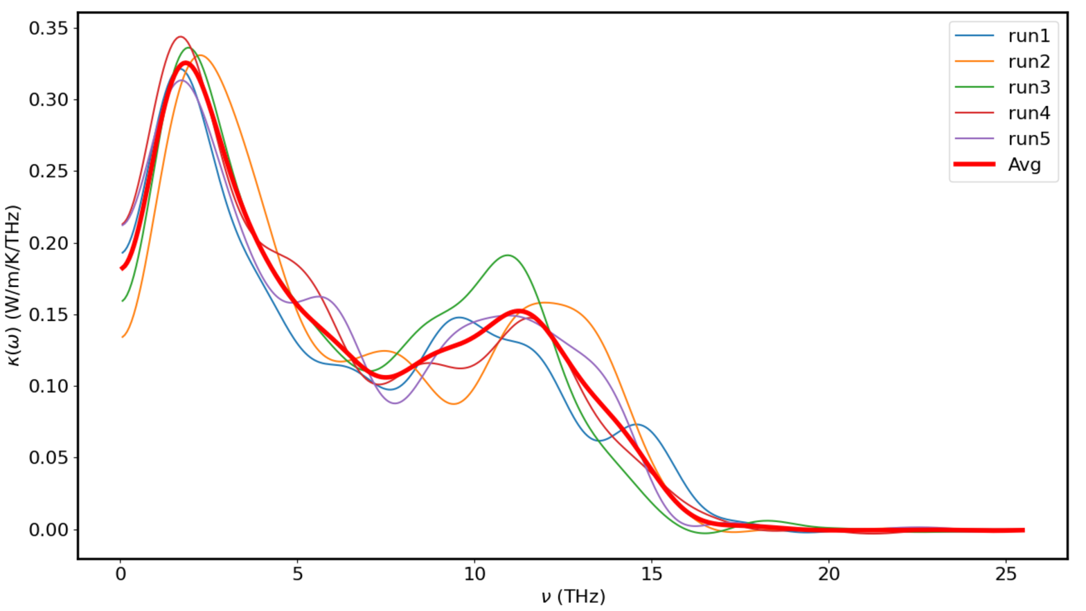
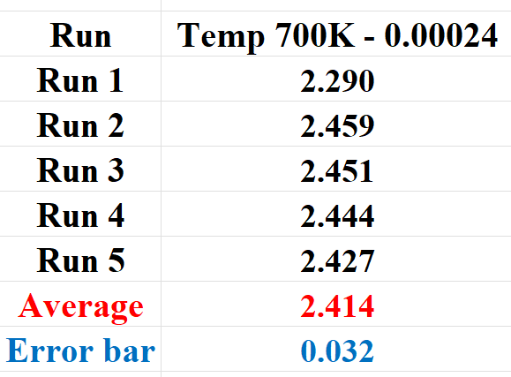
Temp_700K with F=0.00032

Slide 16
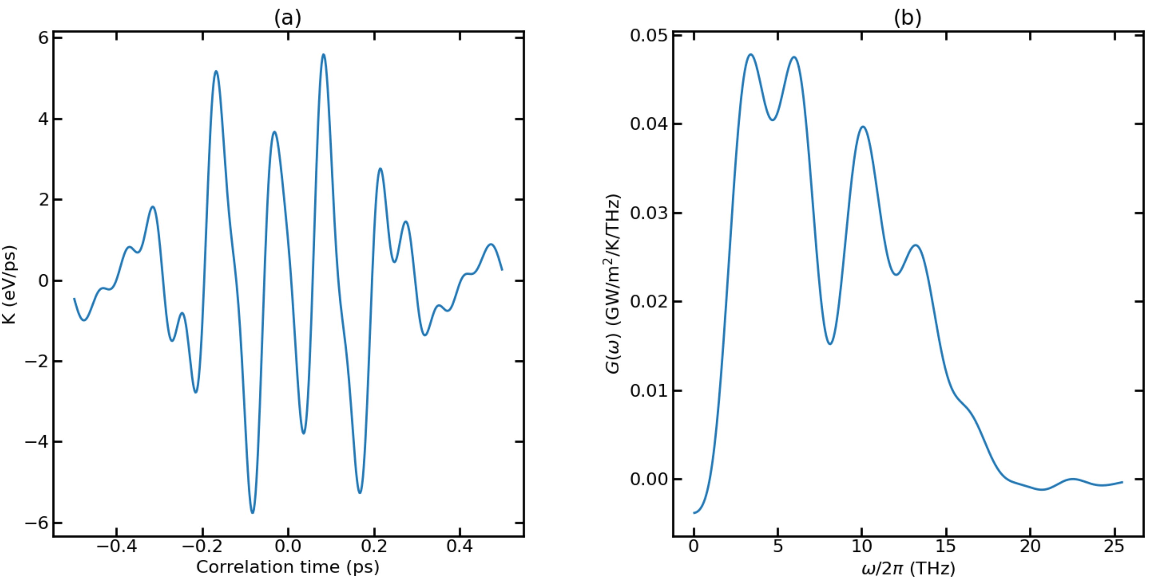
Temp_900K with F=0.0004

Slide 17
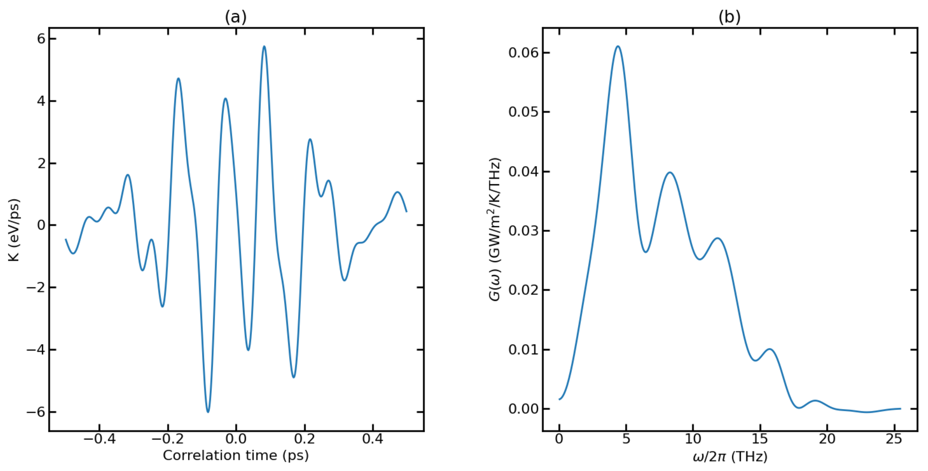
Temp_900K with F=0.0004 (+)

Slide 18
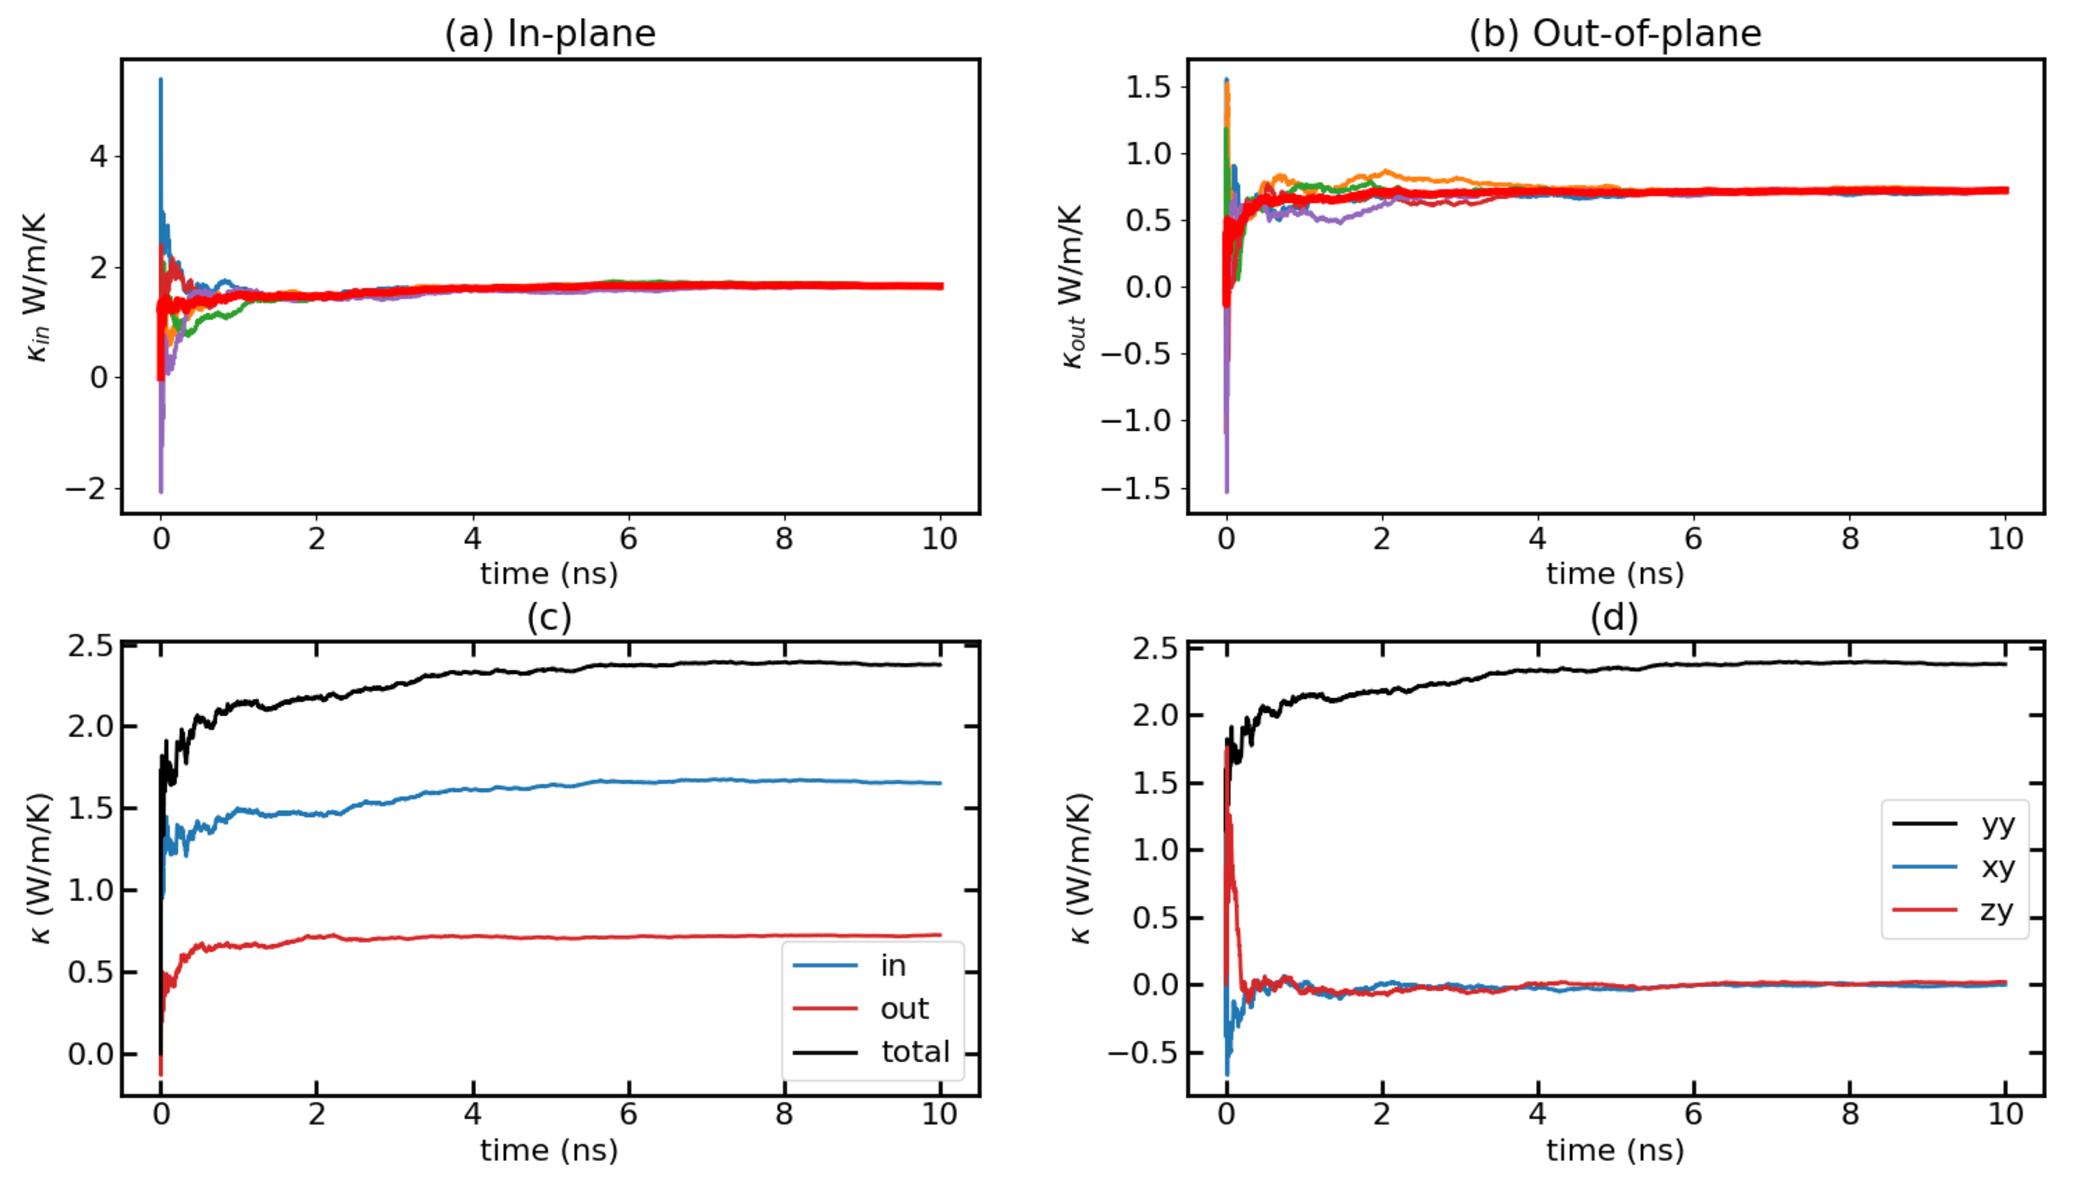
900K NEW with F=0.0004

Slide 19
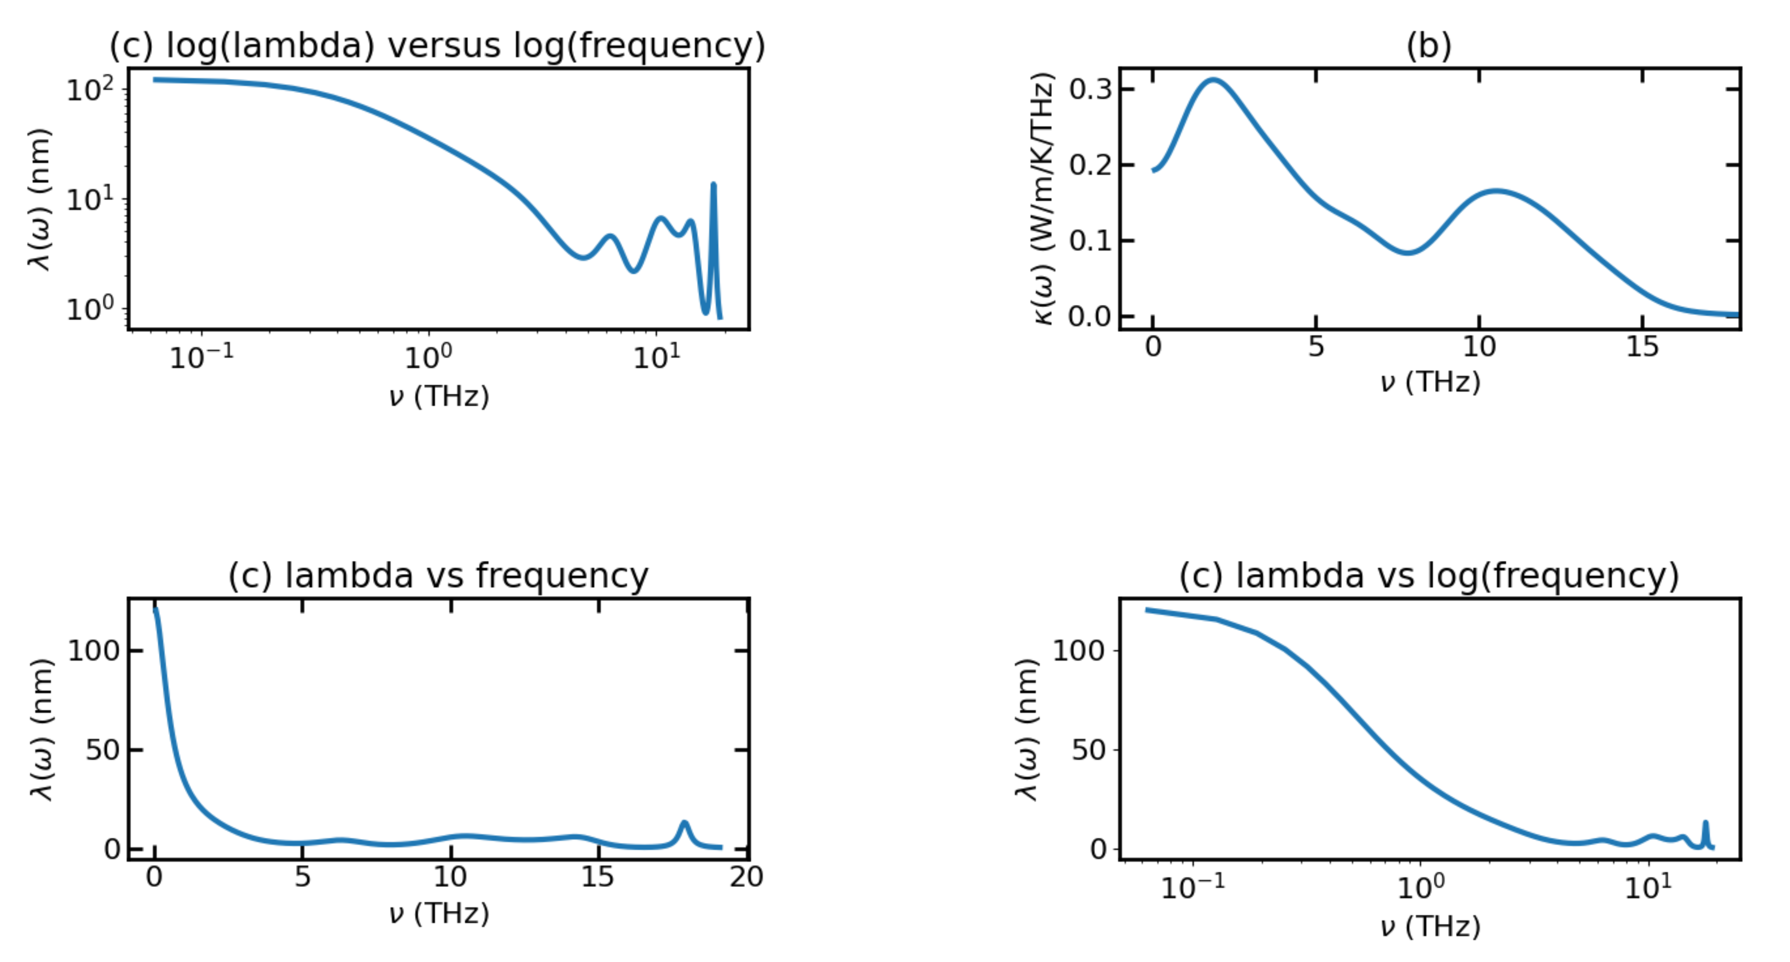
Temp_900K with F=0.0004

Slide 20
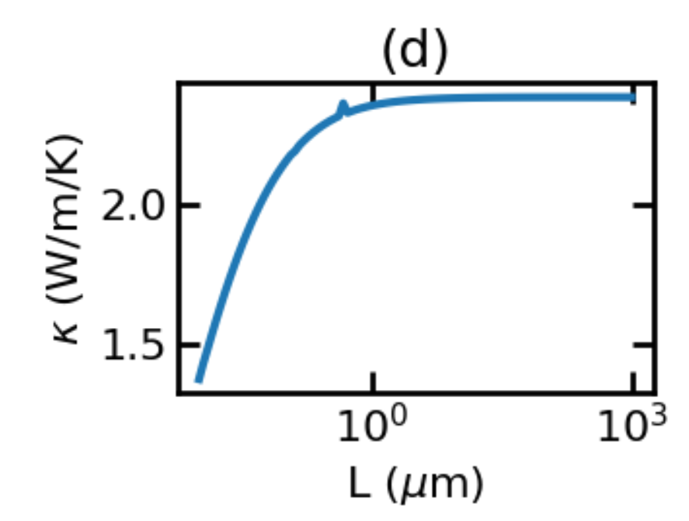
Temp_900 with L-plot

Slide 21
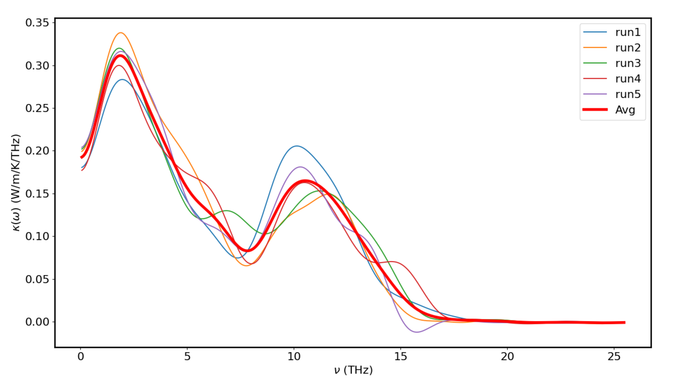
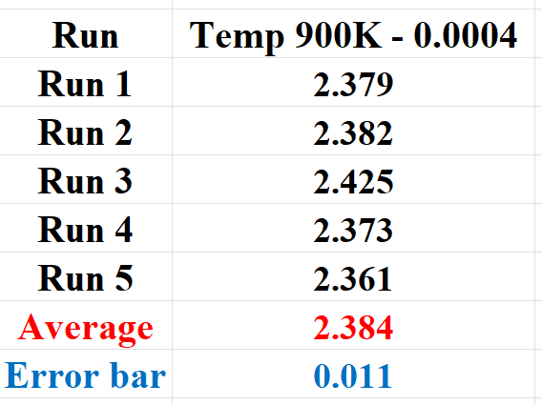
900K NEW with F=0.0004

Slide 22
Npt runs for 900K
Lx: 42.73706887 to 43.23188962
Ly: 42.73706887 to 43.24999569
Lz: 42.73706887 to 43.22970881
→ V did not change much so we can use the original model

Slide 23
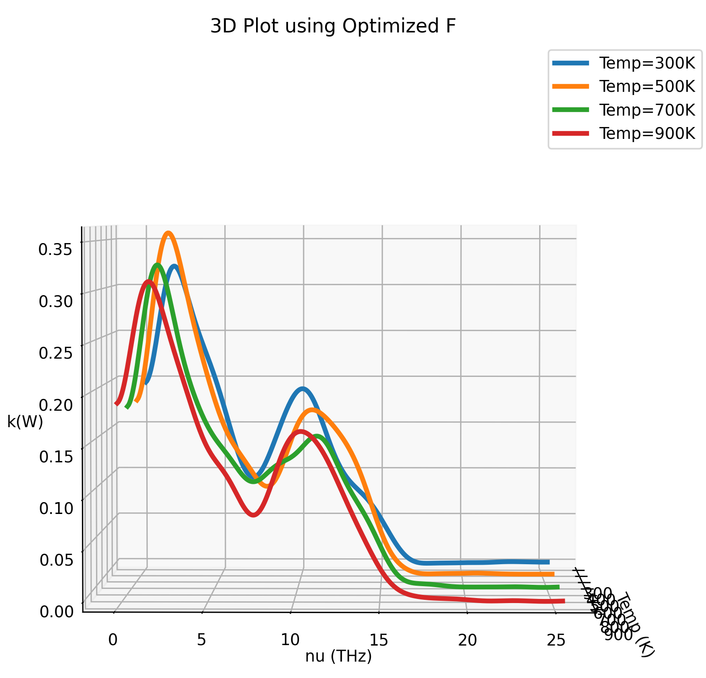
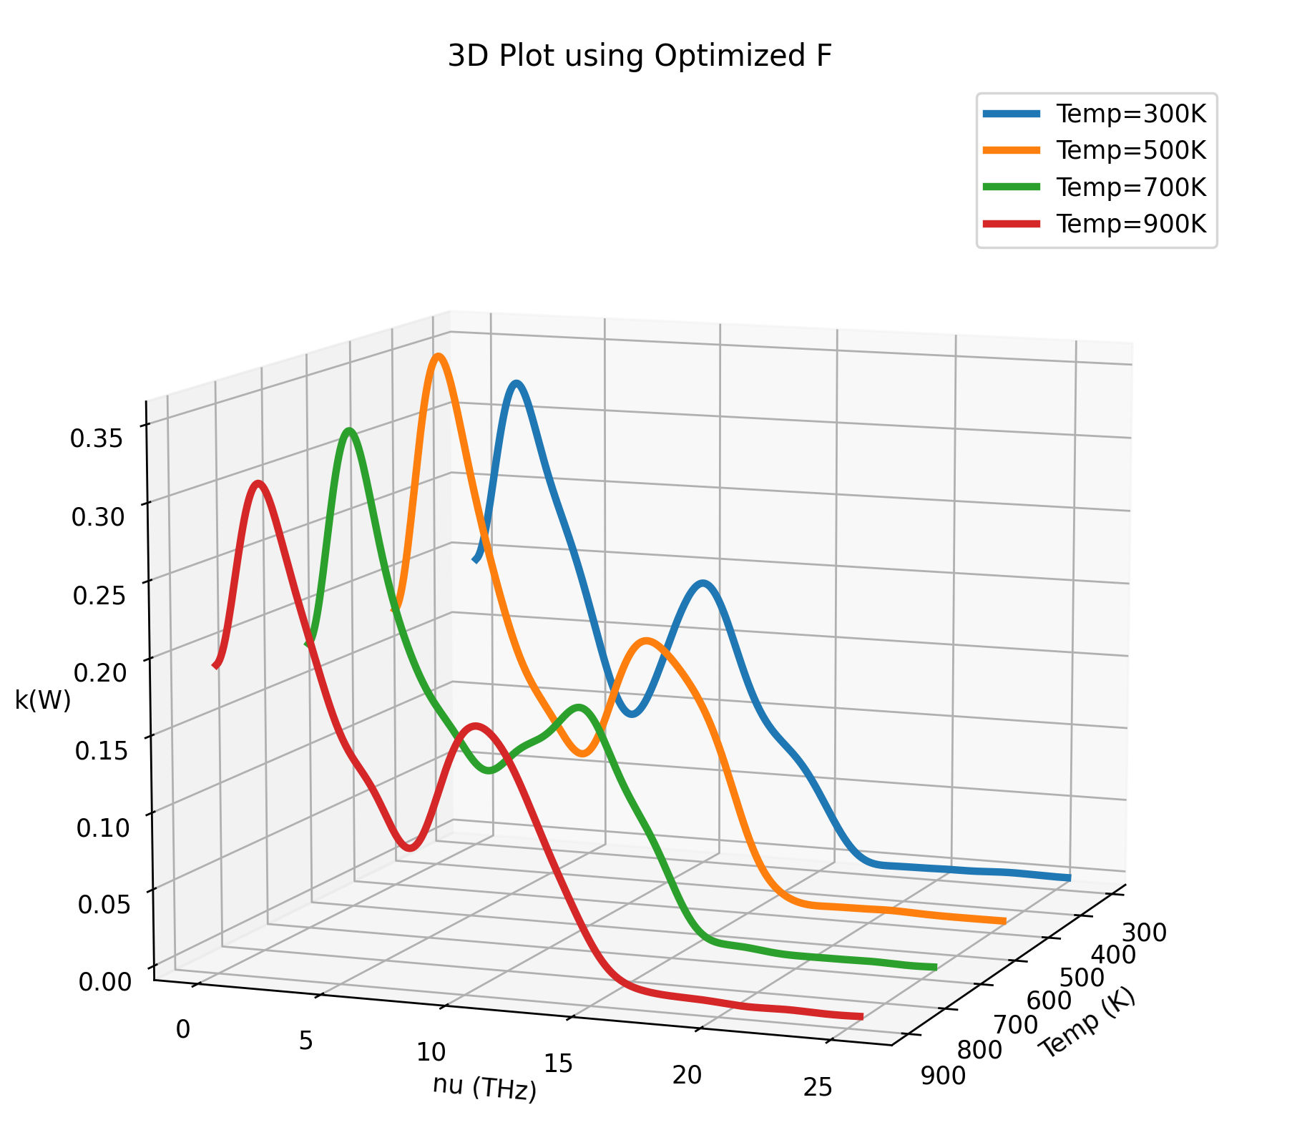
Avg Plots for TC with different F

Slide 24
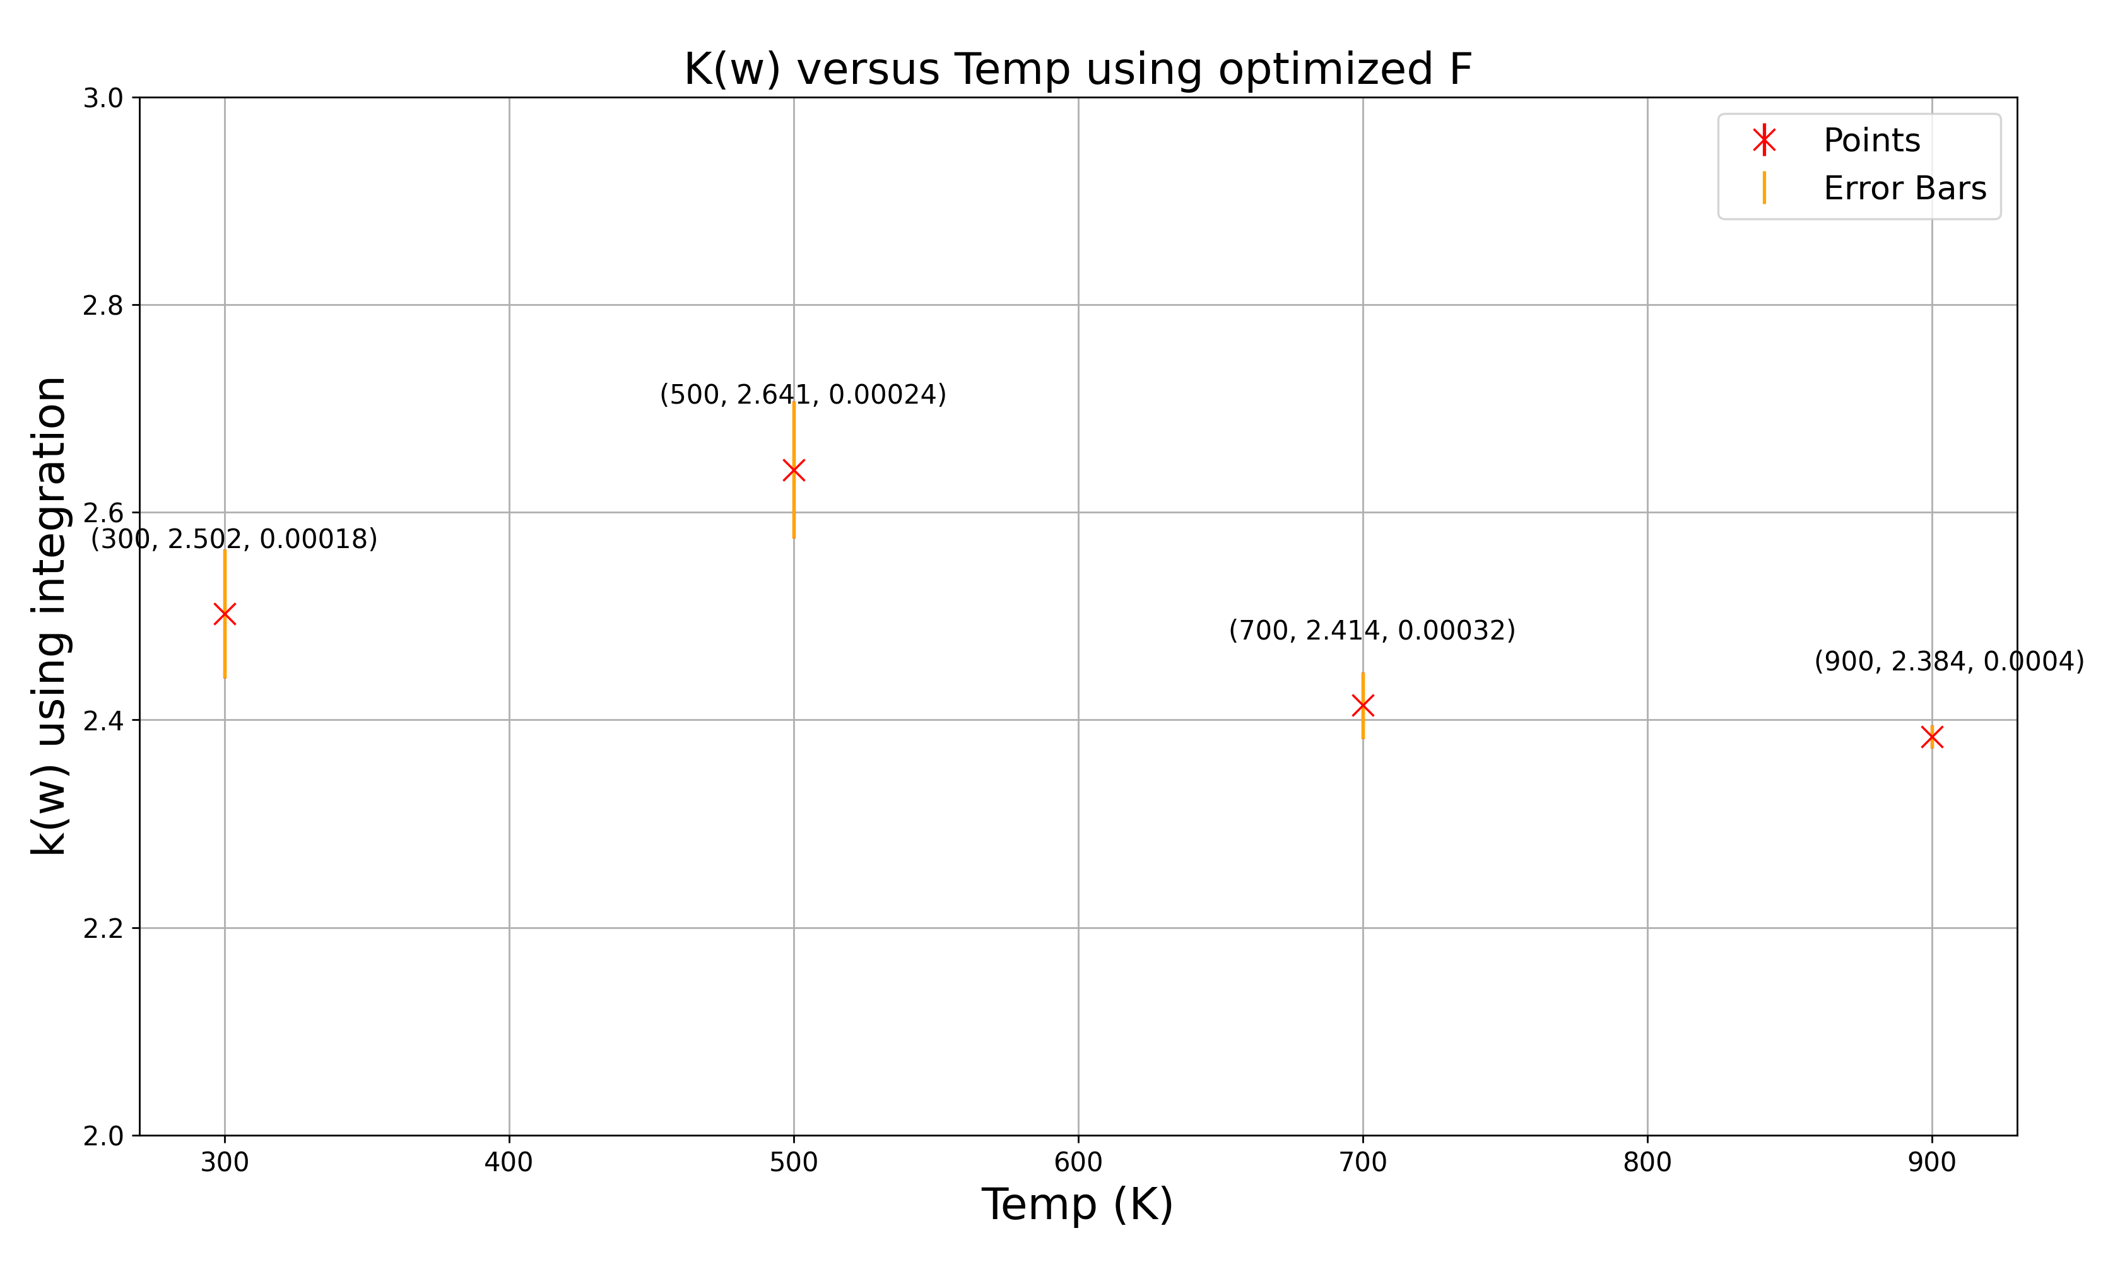
TC vs Temp plots for HEO

Slide 25
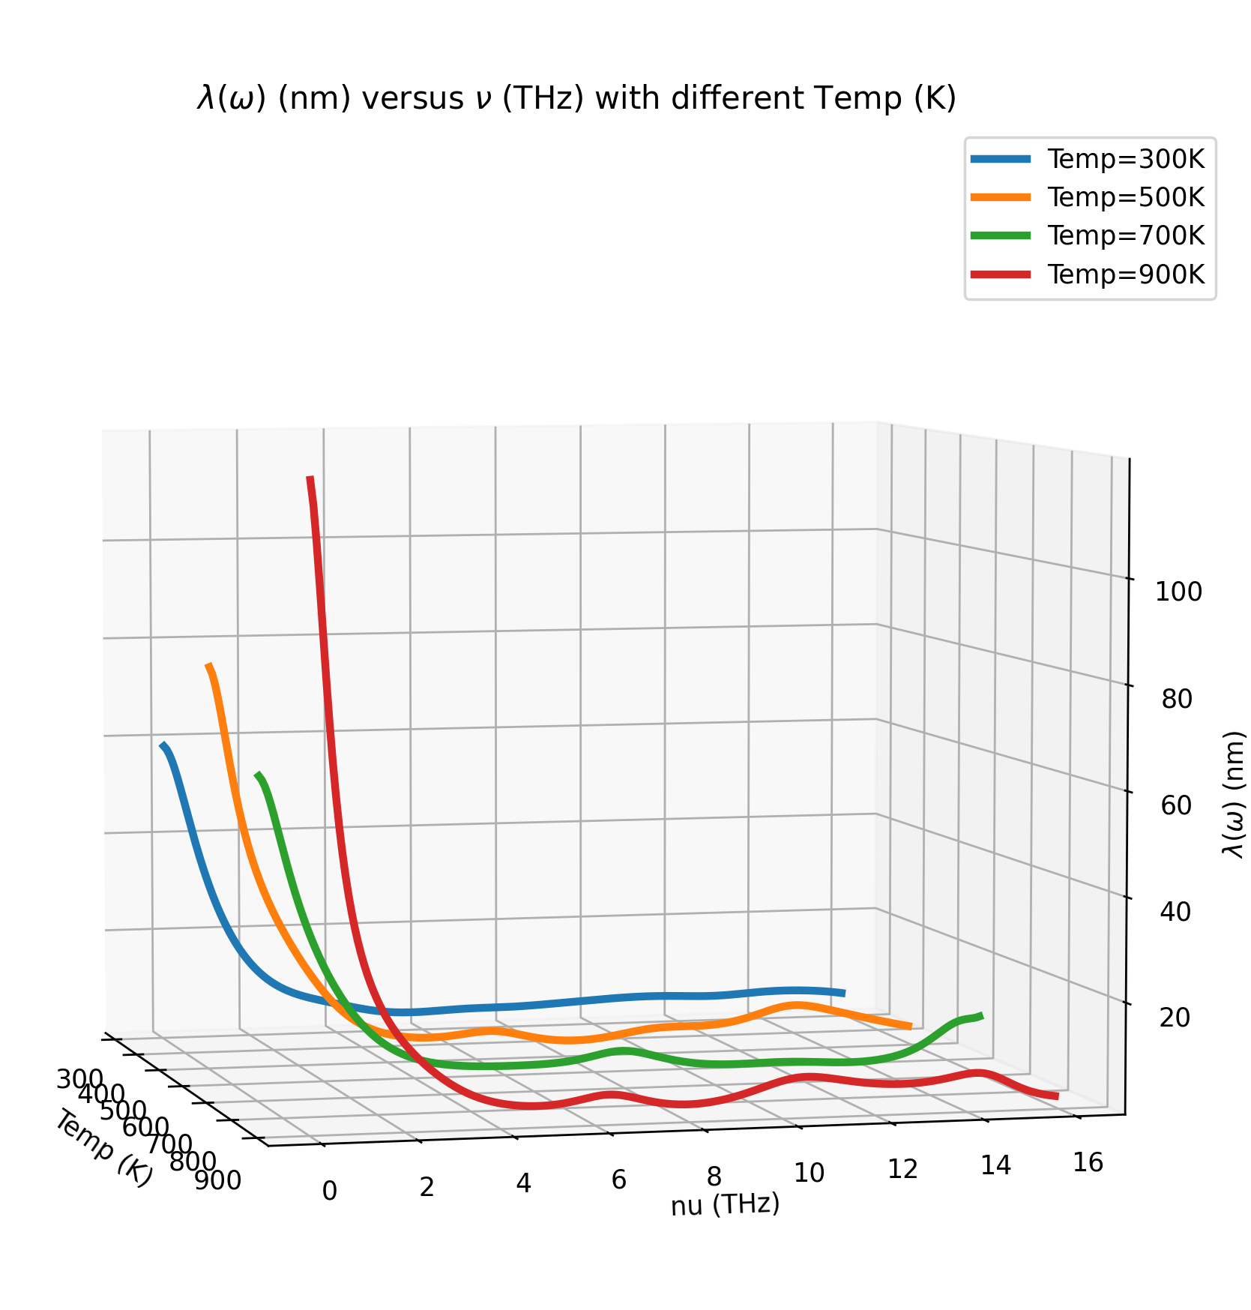
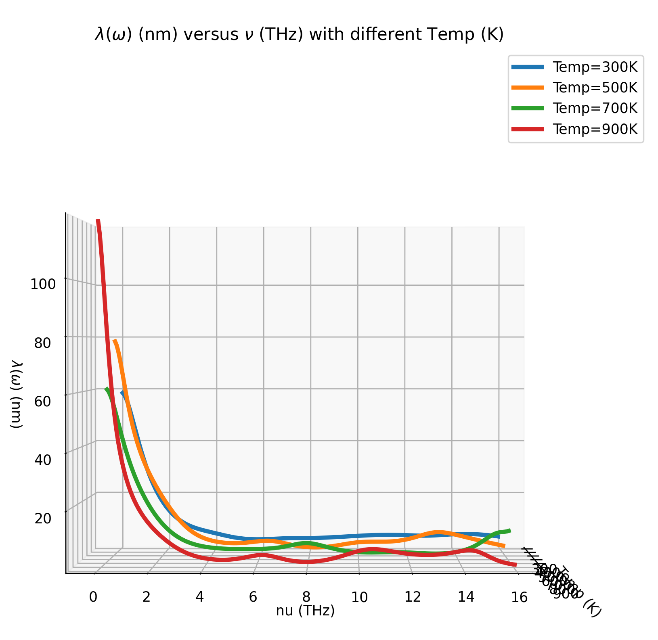
Avg Plots for mFp with different F

Slide 26
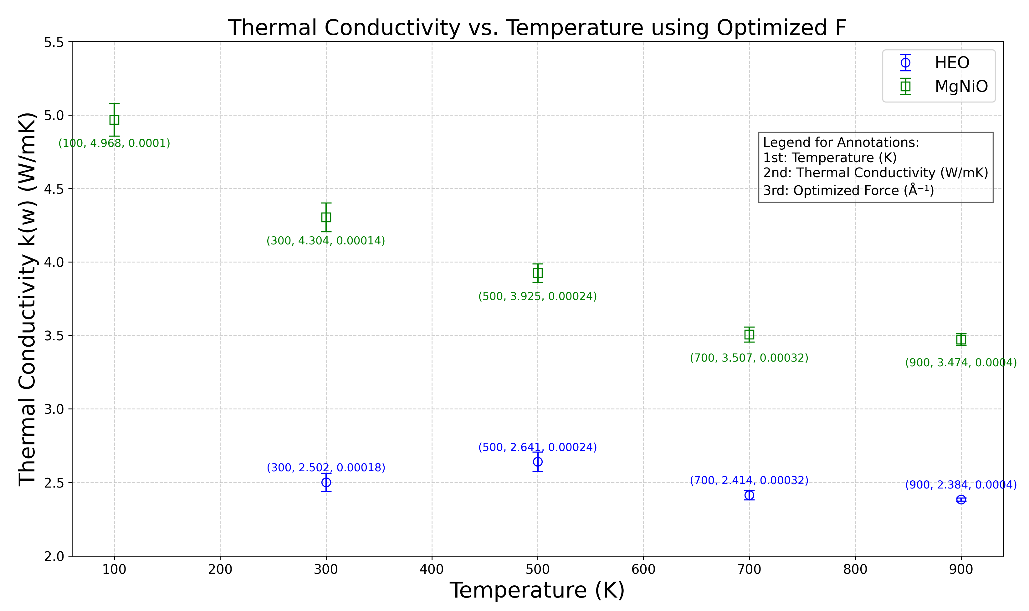
TC plot for HEO and MgNiO

